Slide 1
Products
Tangible goods B2B or B2C
B2C convenience , shopping and specialty
Intangible services

Slide 2
What is a Product?
A PRODUCT is anything that can be offered to a market for attention, acquisition, use, or consumption and that might satisfy a want or need.
Includes:
  Physical Objects
  Services
  Events
  Persons
  Places
  Organizations
  Ideas
  Combinations of the above

Slide 3
What is a Service?
A SERVICE is a form of product that consist of activities, benefits, or satisfactions offered for sale that are essentially intangible and do not result in the ownership of anything.
Examples include:
  Banking
  Hotels
  Tax preparation
  Home repair services

Slide 4
Product Classifications: Consumer
Convenience Products
Buy frequently & immediately
Low priced
Mass advertising
Many purchase locations
i.e Candy, newspapers
Shopping Products
Buy less frequently
Higher price
Fewer purchase locations
Comparison shop
i.e Clothing, cars, appliances
Specialty Products
Special purchase efforts
High price
Unique characteristics
Brand identification
Few purchase locations
i.e Lamborghini, Rolex
Unsought Products
New innovations
Products consumers don’t
want to think about
Require much advertising &
personal selling
i.e Life insurance, blood donation

Slide 5
Product Life Cycle
Sales and
Profits ($)
Sales
Profits
Time
Product
Develop-
ment
Introduction
Growth
Maturity
Decline
Losses/
Investments ($)
Sales and Profits Over the Product’s Life From Inception to Demise

Slide 6
Introduction Stage of the PLC
Summary of Characteristics, Objectives, & Strategies
Sales
Low sales
Costs
High cost per customer
Profits
Negative or low
Marketing Objectives
Create product awareness and trial
Product
Offer a basic product
Price
Usually is high
Distribution
High distribution expenses
Advertising
Spending is high to inform consumers

Slide 7
Growth Stage of the PLC
Summary of Characteristics, Objectives, & Strategies
Sales
Rapidly rising sales
Costs
Average cost per customer
Profits
Rising profits
Marketing Objectives
Maximize market share
Product
Offer new product features and models
Price
Remain where they are or fall slightly
Distribution
Increase number of distribution outlets
Advertising
Educating consumers and meeting competition

Slide 8
Maturity Stage of the PLC
Summary of Characteristics, Objectives, & Strategies
Sales
Begin to slow
Costs
Low cost per customer
Profits
High profits, then lower profits
Marketing Objectives
Maximize profits while defending market share
Product
May modify product
Price
May decline
Distribution
Build more intensive distribution
Advertising
Stress brand differences and benefits

Slide 9
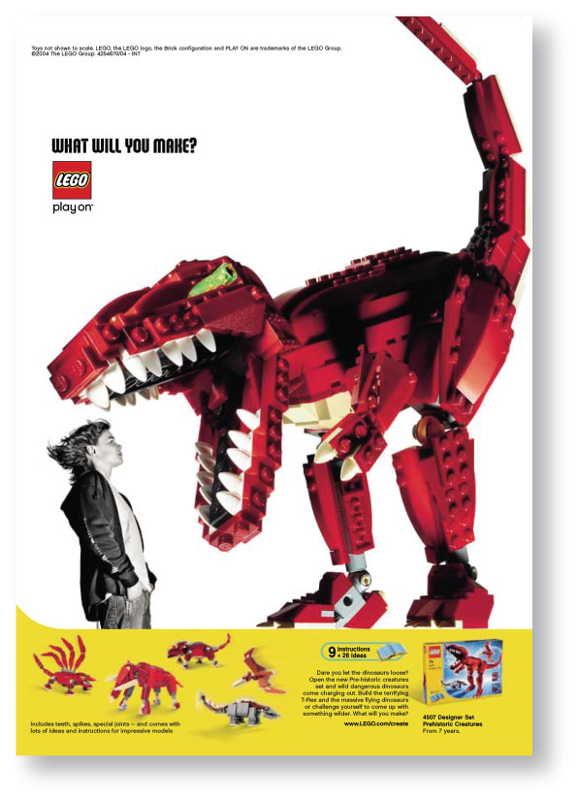
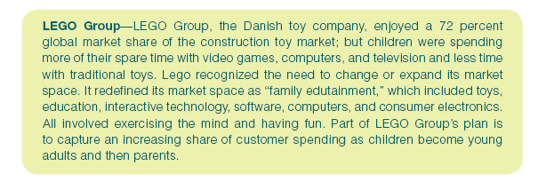
Market Evolution
10-9

Slide 10

Marketing in practice example
Maturity Stage of the PLC
Pfizer INC.
“It is very difficult for people to walk down the street with a bottle of Listerine ,take a swig and spit it out “
And so Pfizer has introduced Cool Mint Listerine’s PocketPack ,oral care strips which dissolve instantly in the mouth .Six years this new convenient form of Listerine not only enabled the brand to reach younger consumers but it also generated $ 120 million in less than a year after its release

Slide 11
Decline Stage of the PLC
Summary of Characteristics, Objectives, & Strategies
Sales
Declining sales
Costs
Low cost per customer
Profits
Declining profits
Marketing Objectives
Reduce expenditure and maintain, harvest, or drop the product
Product
Phase out weak items
Price
Cut price
Distribution
Selective: phase out unprofitable outlets
Advertising
Reduce to level needed to retain
hard-core loyal customers

Slide 12

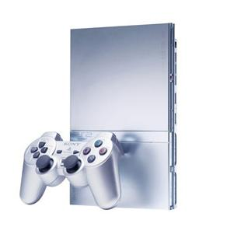
PLC example
When the Sony Playstation 2 entered into the decline stage of its life cycle, Sony had to select a turnaround strategy
Sony’s response: Introduce a slim Playstation 2
This strategy enabled Sony to extend the life of its Playstation 2 until the release of their new next generation system, the Playstation 3

Slide 13
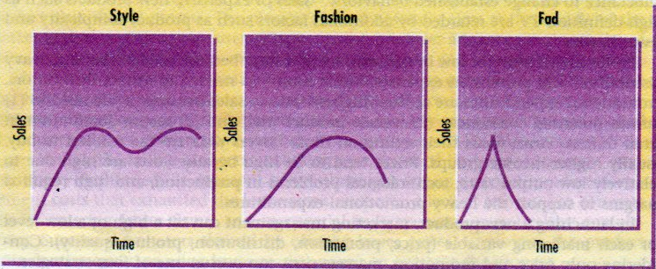
Product life-cycle marketing strategies
Product Life Cycles
Style, Fashion, and Fad Life Cycles

Slide 14
PLC insight
A particular problem faces the manufacturers of classic fragrance brands
There are fashion trends in fragrances and younger consumers may find an established classic fragrance not to their taste
The solution is to launch a variant but maintain the brand values
Poison now has “Tender Poison”

Slide 15
PLC insight
Such brands can also be rejuvenated with limited life products available for a restricted period only (e.g. Jean-Paul Gaultier Summer Fragrance)
However this outcome is not always inevitable
Some products appear to go forever
Chanel No.5 is 80 years young and remains among the top 10 selling perfumes in the twenty first century
Chanel’s success is built on its excellent marketing

Slide 16
Service
Service is an activity or a benefit that one party can offer to another that is essentially intangible and does not result in the ownership of anything.

Slide 17
Products, Services, and Experiences
Tangible Good With Accompanying Services
Service With Accompanying Minor Goods
Pure Tangible Good
Hybrid Offer
Pure Service
Auto With Accompanying Repair Services
Airline Trip With Accompanying Snacks
Soap
Restaurant
Doctor’s Exam
The Product-Service Continuum

Slide 18
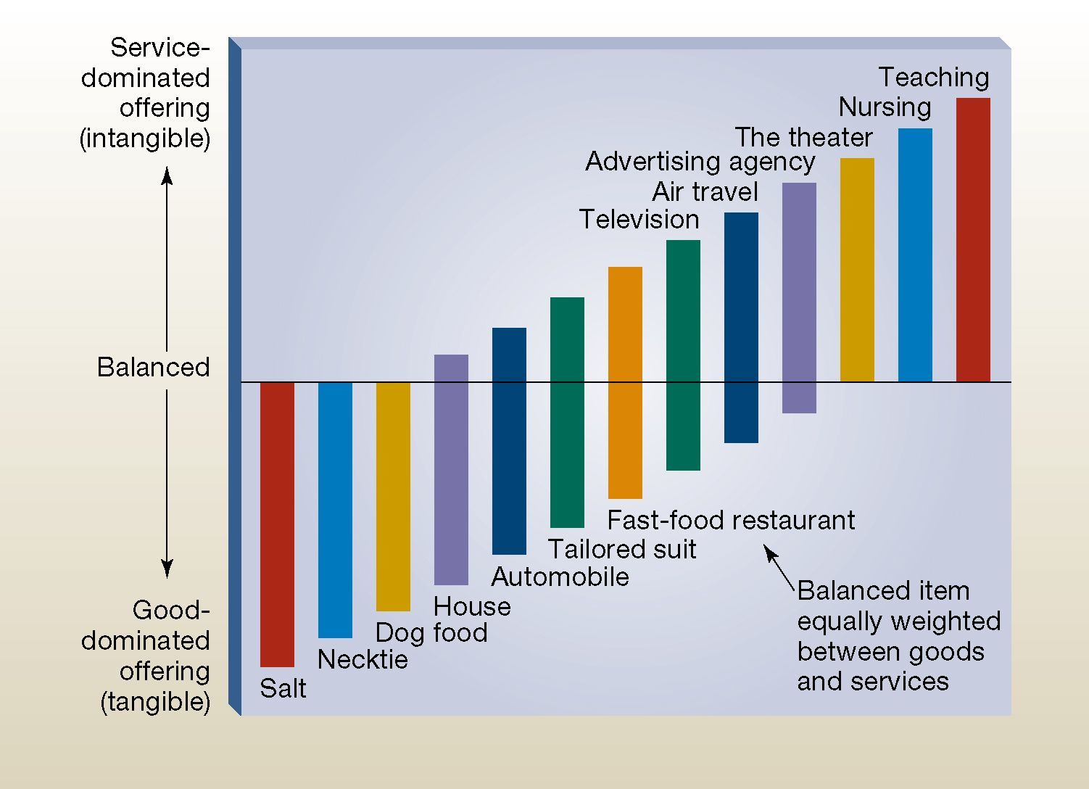
Service continuum

Slide 19
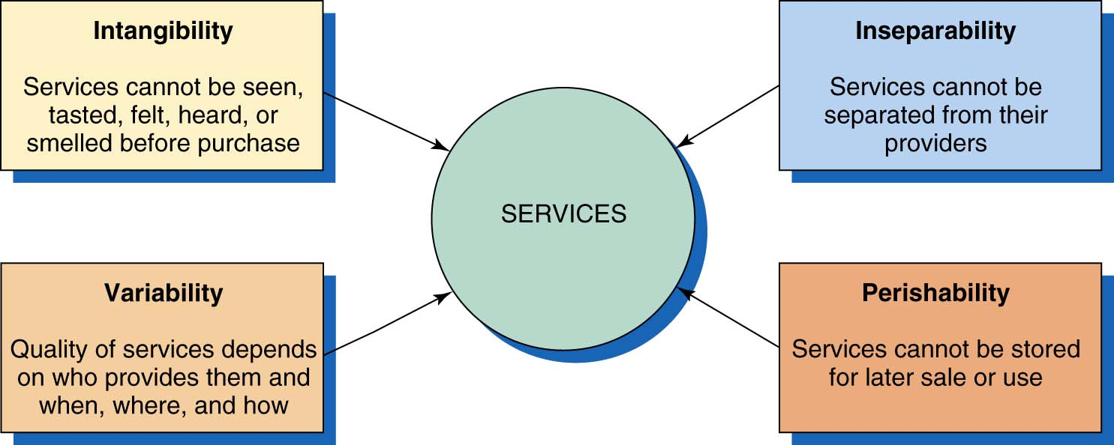
Nature and Characteristic of a Service

Slide 20
Service characteristics & how to deal with each of them (Marketing response)

Slide 21
1-Intangability
* Provide tangibility through:
-Physical appearance of facility
-Furnishings
-Employee uniforms
-Logo
-Website
-Packaging

Slide 22
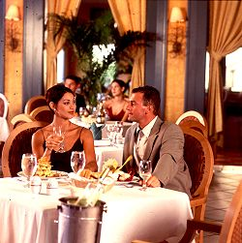
Physical Evidence and Presentation
Place
People
Equipment
Communication material
Symbols
Price

Slide 23
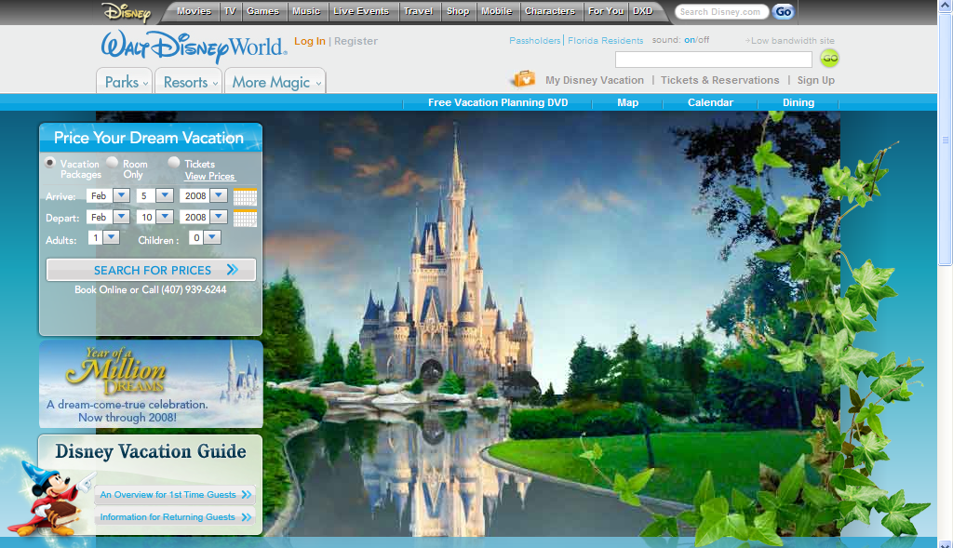
Disney Relies Upon Tangible Cues

Slide 24
2-Perishability
-The perishability of services is not a problem when demand is steady however when demand fluctuates service firms have difficult problems .
Example :because of rush- hour demand public transportation companies have to own much more equipment
-Adjust pricing to influence demand
-Capacity management: adjusting services to match demand

Slide 25
3-Inseparability
-Employee training
-Disintermediation

Slide 26
4-Variability
-Service guarantees
Improving service delivery process
TQM

Slide 27
SERVQUAL model
= service quality
RATER
Reliability
Assurance
Tangibles
Empathy
Responsiveness

Slide 28
Chapter 5
Pricing

Slide 29
Old Russian proverb
There are two kinds of fools in any market. One does not charge enough. The other charges too much

Slide 30
Pricing
Pricing is the monetary value placed upon a product /service by the marketer
Revenue =price x quantity
Revenue=profit + cost
Profit =revenue – cost

Slide 31
Operating cycle and pricing
OC= inventory period (DIO) 50 days+ AR period (DSO) 50 days
OC= 365/ inventory turnover + 365/ AR turnover
Inventory turnover rate= COGS /average inventory
AR turnover rate= net sales / average AR
CCC=OC
Cash 1 100 CCC=100
Credit 25 …………………..100 CCC=75

Slide 32
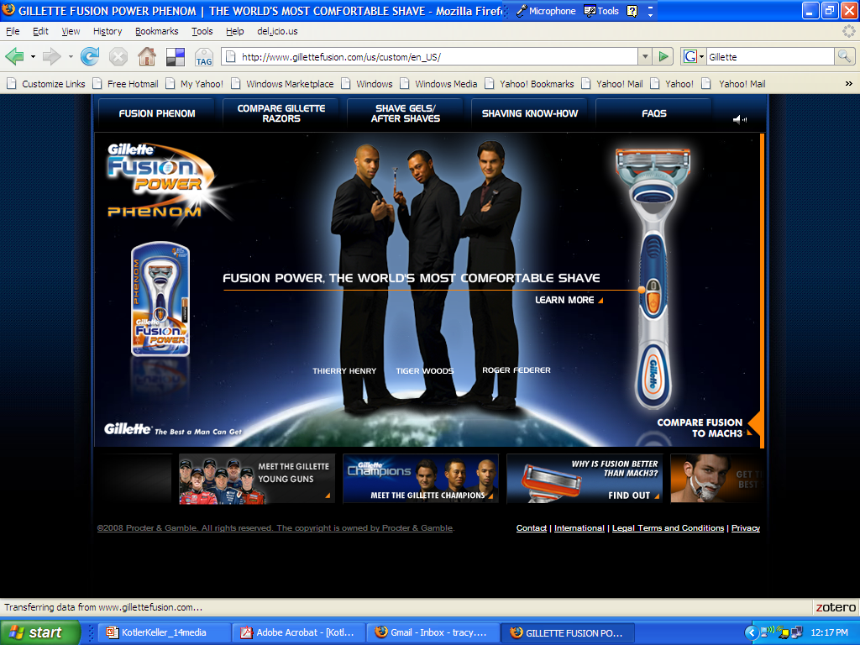
Gillette Commands a Price Premium

Slide 33
Types of Cost Factors that
Affect Pricing Decisions
Variable Costs
Costs that do vary
directly with the
level of production
Raw materials
Fixed Costs
(Overhead)
Costs that don’t
vary with sales or
production levels
Executive Salaries, Rent
Total Costs
Sum of the Fixed and Variable Costs for Any Given
Level of Production

Slide 34
Some expressions
Total cost
Average cost
Fixed costs
Variable costs
Marginal cost
Scale economies

Slide 35
Pricing importance
Price brings together the other elements of the marketing mix, and affects each one of them. For example, price is often used by consumers to judge the likely quality of the product (a product function) and price can also be used as a short-term incentive to buy (a promotion function). Price can also be used to encourage people to buy on-line (a process function).
Price determines the firm’s income and profits for each product and each market. A relatively small increase in price can lead to a very large increase in profits, unless of course the higher price means customers buy competing products instead.

Slide 36
Pricing importance
Price contributes to the firm’s business and financial objectives. Pitching a low price will probably increase unit sales (at the cost of losing profit), so price can be used to control demand, perhaps in order to maintain efficient use of production capacity. This is particularly important in service industries, where the product cannot be stockpiled – this is why many restaurants offer early-evening discounts or weekday discounts, to use capacity at less popular times.
Price can operate as a competitive tool – with care. Competing by reducing prices can lead to retaliation by competitors, and a price war will always favour the firm with the most cash resources

Slide 37
Contribution
Contribution =selling price – variable cost

Slide 38
Revenue = cost + profit
Profit =revenue –cost

Slide 39
Breakeven analysis
The point at which total revenue is exactly equal to the total cost of production and marketing

Slide 40
Economy of scale
Definition:
Getting discounts for buying materials and services of bulk
Technical
-Commercial (marketing)
-Financial

Slide 41
Breakeven Analysis or Target Profit Pricing
Tries to Determine the Price at Which a Firm Will Break Even or Make a Certain Target Profit.
Total Revenue
12
10
Target Profit
($2 million)
Cost in Dollars (millions)
8
6
Total Cost
4
Fixed Cost
2
200
400
600
800
1,000
Sales Volume in Units (thousands)

Slide 42
Breakeven analysis
Breakeven analysis = fixed cost / contribution per unit
Contribution margin=selling price –variable cost

Slide 43
Fixed cost =100,000
Variable cost per unit = 20
Selling price =50
BEP =100,000 / 30 = 3333
Contribution margin = 50-20 = 30

Slide 44
Perspectives on pricing decisions
1-Economist’s perspective
-Demand / supply
-Elasticity
-Competition
2-Accountant’s perspective
-Costs
-Profitability

Slide 45
Perspectives on pricing decisions
3-Marketer’s perspectives
-Price sensitivity
-Competition
-Promotion
-Product positioning
-Market share

Slide 46
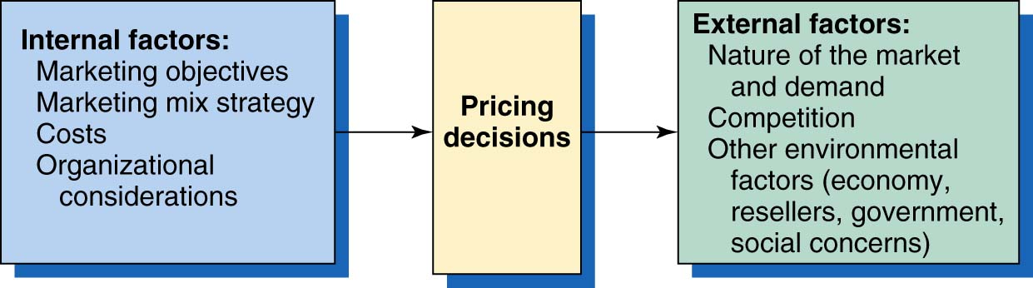
Factors Affecting Price Decisions

Slide 47
4 Cs on price setting
Cost
Company objective
Customer
Competitor

Slide 48
Total fixed cost 100,000
Raw materials / unit =10
First year 2000 units =60
Second year 4000 units =35

Slide 49
Industry structure
Monopoly
Oligopoly concentrated
Pure (perfect) competition frag

Slide 50
40 % leader
30% challenger
20% follower
10% Nicher

Slide 51
Industry structure
Monopoly
Oligopoly = small no of large comp
Pure / perfect competition

Slide 52
Influences on Price
EXTERNAL
Customers/
Consumers
Pricing
Objectives
Supply & Demand
PRICING
Decision
Organization
Objectives
Competitors
Channels of Distribution
Marketing Mix
Variables
Legal & Regulatory
INTERNAL
Beamish & Ashford, 2007

Slide 53
Perceived Value (value proposition)
PLC
Benefit/
Functionality
Price in exchange for perceived value and benefits
PERCEIVED
VALUE
Differentiation
Quality
Prestige/ status
of brand
Service
Support
Ease of use
Substitutes
Value added
measures
Price your product at the level that your customers expect for the quality you deliver
Beamish & Ashford, 2007

Slide 54
Internal Factors Affecting Pricing Decisions: Marketing Objectives
Survival
Low Prices Hoping to Increase Demand.
Marketing
Objectives
Current Profit Maximization Choose the Price that Produces the Maximum Current Profit, Etc.
Market Share Leadership
Low as Possible Prices to Become
the Market Share Leader.
Product Quality Leadership
High Prices to Cover Higher
Performance Quality and R&D.

Slide 55
Internal Factors Affecting Pricing Decisions: Marketing Mix Strategy
Customers Seek Products that Give Them the Best
Value in Terms of Benefits Received for the Price Paid.
Product Design
Nonprice
Positions
Price
Distribution
Promotion

Slide 56
External Factors Affecting Pricing Decisions
Market and
Demand
Competitors’ Costs,
Prices, and Offers
Other External Factors
Economic Conditions
Reseller Reactions
Government Actions
Social Concerns

Slide 57
Market and Demand Factors Affecting Pricing Decisions
Pricing in Different Types of Markets
Pure Competition
Many Buyers and Sellers
Who Have Little
Effect on the Price
Pure Monopoly
Single Seller
Monopolistic
Competition
Many Buyers and Sellers
Who Trade Over a
Range of Prices
Oligopolistic
Competition
Few Sellers Who Are
Sensitive to Each Other’s
Pricing/ Marketing
Strategies

Slide 58
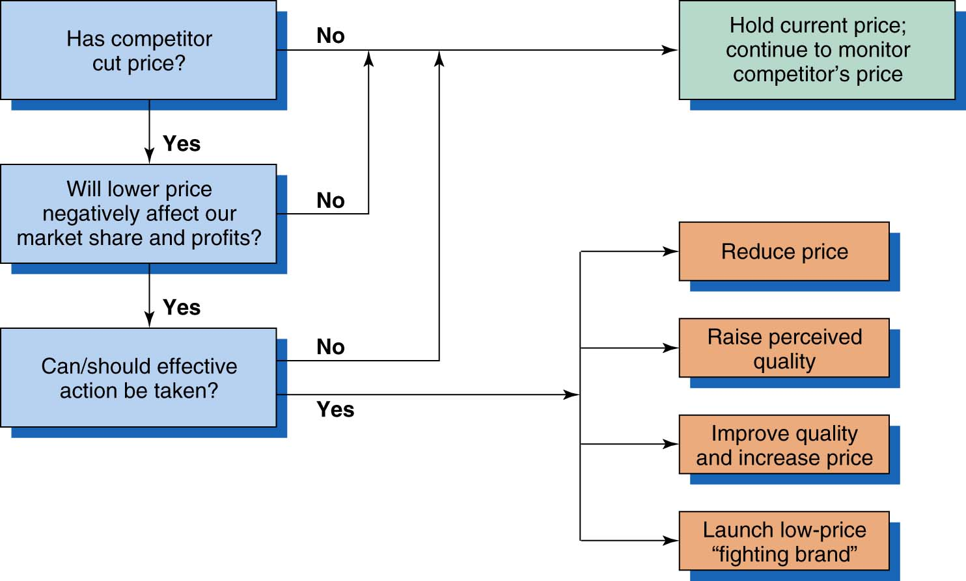
Possible Solution to Price Cuts

Slide 59
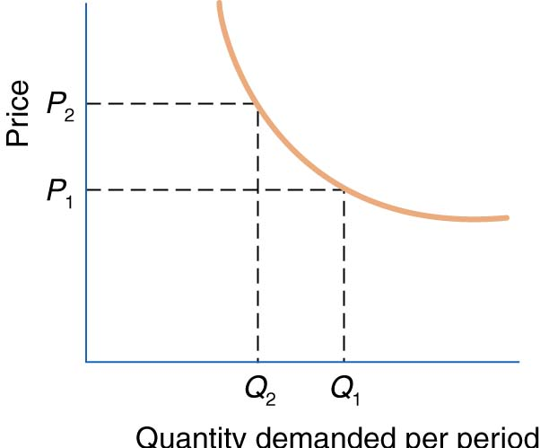
Demand Curve

Slide 60
Price Elasticity of Demand
A. Inelastic Demand -
Demand Hardly Changes With
a Small Change in Price.
Price
P2
P1
Q2
Q1
Quantity Demanded per Period
B. Elastic Demand -
Demand Changes Greatly With
a Small Change in Price.
Price
P’2
P’1
Q2
Q1
Quantity Demanded per Period

Slide 61
Price Elasticity of Demand
Change in quantity demanded %
Change in price %
-When elasticity is greater than 1 ----- Elastic
-When elasticity is less than 1 ----- Inelastic

Slide 62
Price inelastic products
No competitors
No substitute
High demand
Essential
High quality
Well known

Slide 63
X y 20% price increase
X demand 40% 40/20 =2 = elastic
Y demand 10% 10/20= 0.5 = inelastic

Slide 64
Price & Product Adoption Process
use
innovators
Early
adopters
Early
Majority
Late
Majority
laggards
time
Beamish & Ashford, 2007

Slide 65
Case Study: iPhone price

Slide 66
Case Study: iPhone price
TimesOnline, 7 September 2007

Slide 67
Pricing methods

Slide 68
Methods
Skimming
Penetration
Cost plus
Captive
Competitive … going rate
Psychological ….odd even 9.99$
Loss leader
EDLP
Trial pricing
Popcorn pricing

Slide 69
iPhone 13
Perfume for social class A women
El Namleteen
Appartment in I city 5th settlement beside AUC

Slide 70
Skimming
Selling a new product with a very high price
The product should innovative
Advantages ….
Disadvantages

Slide 71
Penetration
Selling a new product with a very low price
The product is a copy or generic
Advantages
Disadvantages

Slide 72
Cost plus
Selling a new product with profit margin up to 25%
The product is a copy or generic
Advantages
Disadvantages

Slide 73
Cost plus / penetration
Cost
10=12.5
20=25
Penetration
10x100=1000
8x110=880

Slide 74
Cost plus= markup

Slide 75
Strengths of cost plus pricing
It is an easy method to be calculated
It can be seen to be fairer to both buyers and sellers
It provides a means of trying to ensure that all overheads are met in addition it tries to allow for profit return

Slide 76
Weaknesses of cost plus pricing
It takes no account of other elements in the marketing mix like product or place
It may be difficult to identify direct costs and overheads for each item
It does not reflect customers perceptions :cheap price =poor product
It does not consider the needs of customers
It does not consider the elasticity of demand for the product

Slide 77
Competition-Based Pricing
Methods for Setting Prices
Going-Rate
Company Sets Prices Based on What
Competitors Are Charging
Sealed-Bid
Company Sets Prices Based on
What They Think Competitors
Will Charge
?
?

Slide 78
Tender
Reverse auction
Forward auction

Slide 79
New-Product Pricing Strategies
(Pioneer Pricing strategies)
Use Under These Conditions:
  Product’s Quality and Image Must Support Its Higher Price.
  Costs Can’t be so High that They Cancel the Advantage of Charging More.
  Competitors Shouldn’t be Able to Enter Market Easily and Undercut the High Price.
Market-Skimming
Setting a High Price for a New Product to “Skim” Maximum Revenues from the Target Market.
Results in Fewer, But More Profitable Sales.
I.e. Intel

Slide 80
Example of skimming pricing
Apple launched its iPhone in this way, a high price was set and product availability was through a specific telephone network (rather than being available on all networks)

Slide 81
Strengths of skimming pricing
It allows for quick recovery on investment in the new product
It provides prestigious/quality image to customers
Higher prices are likely to appeal to innovator groups

Slide 82
Weaknesses of skimming pricing
It may encourage the competitors to enter the market quickly
It results in lower levels of sales and so fewer economies of scale
It may attract attention from regulatory bodies

Slide 83
Skimming
It is commonly used in consumer electronics market
Recent research shows that customers are aware of skimming in electronics markets and are delaying purchases of new electronic devices until the prices drop

Slide 84
New-Product Pricing Strategies
Use Under These Conditions:
  Market Must be Highly Price-Sensitive so a Low Price Produces More Market Growth.
  Production/Distribution Costs Must Fall as Sales Volume Increases.
  Must Keep Out Competition & Maintain Its Low Price Position or Benefits May Only be Temporary.
Market Penetration
Setting a Low Price for a New Product in Order to “Penetrate” the Market Quickly and Deeply.
Attract a Large Number of Buyers and Win a Larger Market Share.
I.e. Dell

Slide 85
Strengths of penetration pricing
Large sales volume
Economy of scale
Prevent competitors from entering the market

Slide 86
Weaknesses of penetration pricing
It is often difficult to raise price after using this policy
It may not be appropriate due to costs of R&D and competitor positions

Slide 87
Strategic Pricing
Price Skimming | Price Penetration
High price/ unit | Low price/unit
New products with little price sensitivity (introduction stage of PLC) | When you want to acquire large MS
Drop price when market comes into existence | Applies to “me too” products
Market can be segmented easily | Low price aided by high promotions
Profit is made on a per unit base | Profit is made through volume sales
Beamish & Ashford, 2007

Slide 88
New-Product Pricing
Skimming Price
  A very high, premium price
  Product is new & highly desirable with unique benefits
  Demand is highly inelastic
  Allows the company to recover R&D & promotional costs
  There is a high barrier for entry to competitors
Penetration Pricing
  A very low price to encourage consumers to buy
  The objective is to sell more at a short period of time
  Discourage competitors to enter the market (increase entry barriers)
Trial Pricing
  Pricing a new product low for a limited period of time in order to lower the risk for consumers
  Win customer acceptance first, and then make profits later

Slide 89
Perceived value pricing
Is perhaps one of the most marketing oriented ways of setting prices
The price is set on the perceived value of the product to the customer
The marketer uses other elements of the mix (product or promotion ) to build the perceived value of the product or service in the mind of customers

Slide 90
Demand pricing
This method is customer-oriented, because prices are set at a level that will ensure that demand for the product is at a point that will meet corporate objectives. For example, a company may be able to produce economically at a particular level, so the price will be set to ensure that demand reaches that level, no more and no less. Alternatively, demand pricing can be used to determine the point at which profit will be maximized, i.e. the point at which a further increase in price will reduce the production run past the most economical point.

Slide 91
EDLP
- An important type of value pricing is everyday low pricing which involves charging a constant , everyday low price with few or no temporary price discounts. In contrast , high –low pricing involves charging higher prices on an everyday basis ,but running frequent promotions to temporarily lower prices on selected items below the EDLP level
The king of EDLP is Wal-Mart that practically defined the concept

Slide 92
To offer everyday low prices a company must first have everyday low costs

Slide 93
Pricing for Multiple Products
  Price bundling (e.g., monitor, keyboard, CPU in a computer package)
  Captive pricing (e.g., razors and razor blades)

Slide 94
Product Mix-Pricing Strategies
Optional-Product
  Pricing optional or accessory products sold with the main product. i.e camera bag.
Captive-Product
  Pricing products that must be used with the main product. i.e. film.

Slide 95

Captive pricing
HP began drastically cutting prices on its printers by as 60% in some cases. HP could afford to make such dramatic cuts because customers typically spend twice as much on replacement ink cartridges ,toner, and specialty paper as on the actual printer over the life of the product .As the price of the printers dropped printer sales rose. HP now owns about 40% of the worldwide printer business

Slide 96
Promotional Pricing
Loss Leaders
Special-Event Pricing
Cash Rebates
Temporarily Pricing Products Below List Price Through:
Low-Interest Financing
Longer Warranties
Free Maintenance
Discounts

Slide 97
Loss-Leader Pricing
  Deliberately selling a product below its customary price to attract attention to it.

Slide 98
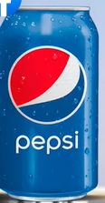

Loss-Leader Pricing
Neck of items
Tammimi in Saudi Arabia and Pepsi

Slide 99
Psychological Pricing
Considers the psychology of prices and not simply the economics.
Customers use price less when they can judge quality of a product.
Price becomes an important quality signal when customers can’t judge quality; price is used to say something about a product.
Retail $100.00
Cost $3.00

Slide 100
Odd-even pricing 9.99
Certainly it is less effective in some markets. An extension of this type of pricing is found in China, where some numbers are regarded as lucky; collectively, pricing that creates perceptions of this type is called psychological pricing.

Slide 101
Prestige Pricing
  Setting a high price so that status-conscious consumers will be attracted to the product and buy it.

Slide 102
Popcorn pricing
Then there is the actual pricing for popcorn options, and the use of decoy items – you’ve probably noted popcorn most often comes in three sizes/prices. National Geographic’s Brain Games recently ran an experiment on this. Here’s what they did:
The first group in the experiment was offered only small or large serves, priced at $3 or $7. The majority chose to buy the small popcorn. Their rationale? Either the $7 popcorn was too expensive or that the small was a better size for their appetite.
A second group was then offered three sizes, small for $3, medium for $6.50, and large at $7. Faced with this broader choice, a much higher number went for large. Their rationale? It only cost an extra 50c to get the large size. In effect they saw value in “more” popcorn for only $0.50.

Slide 103
Segmented Pricing

Slide 104
Price discrimination
(differential pricing)
1-By time
2-By place
3-By person
-Price discrimination is useful especially in services
where the marketer will charge different prices to iron out fluctuations in demand
-Example: airline - hotels

Slide 105
Predatory Pricing (dumping)
Means that a company sets a very low price for the purpose of driving competitors out of business

Slide 106
International pricing(INCOterms)
EX-works =ex factory
FOB (Free On Board)
C&F (CFR) = cost / freight
CIF = cost / insurance/ freight
DDP=Delivery Duty Paid

