Slide 1
Promotion

Slide 2
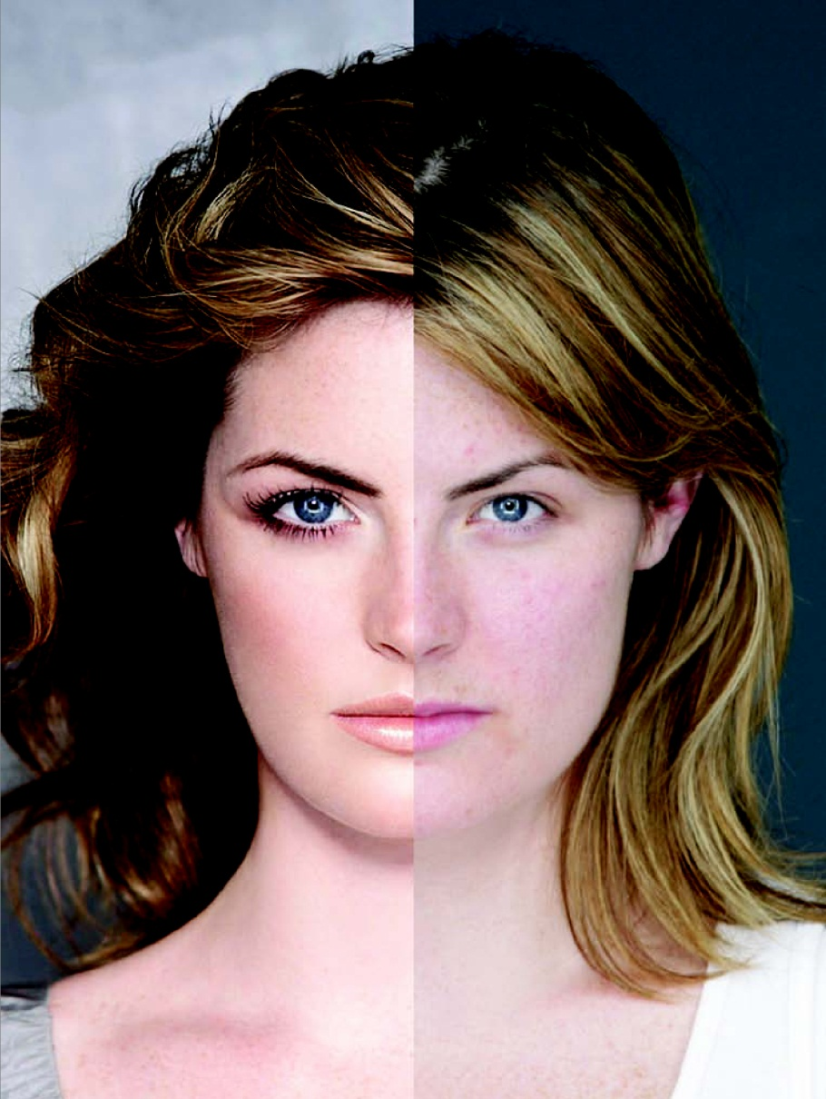
Dove’s Campaign for Real Beauty

Slide 3
Marketing Communication Mix or Promotion Mix
Advertising
Product’s Design
Sales Promotion
Stores that Sell the Product
Direct Marketing
Product’s Price
Public Relations
Personal Selling
Product’s Package

Slide 4
Advertising
TV
Radio
Press
Online
Outdoors

Slide 5
Sales promotion
B2b or b2c
B2C contest / sweepstake
B2b bonus / discount

Slide 6
B2C sales promotion
BOGOF
Discount
Sample
Gift with purchase
Coupons
Contest
Sweepstake
Loyalty programs

Slide 7
B2B sales promotion
Discount
Bonus
Loyalty programs

Slide 8
PR
Standalone events
Exhibitions
Sponsorship
CSR
Press release
Press conference

Slide 9
Direct marketing
Email …ESP …. Mailchimp
SMS …… LBB

Slide 10
Selling process / sales call
Prospection
Pre-approach
Approach
Presentation
Objection handling
Closing
Follow up

Slide 11
Tv
Radio jingle timing
Press
Outdoors OOH .. Billboards / susit / flags
Indoors
Online…… search /video/display

Slide 12
Direct marketing
Email ….ESP ….mailchimp
SMS …. Bulk ……. LBB
Phone

Slide 13
Selling process x sales call
Prospection
Pre-approach
Approach
Presentation
Handling objections
Closing
Follow up

Slide 14
Consumer Sales promotion
BOGOF
Discount
samples
Coupons
Gift with purchase
Contest
Sweepstake
Loyalty programs

Slide 15
Trade sales promotion
Bonus
Discount
Loyalty programs

Slide 16
Public relations
Sponsorship
Exhibition
Press release
Press conference
CSR
Standalone events

Slide 17
Advertising is better for creating awareness; personal selling is more effective at promoting action and purchase behavior.

Slide 19
Sender
Encoding
Media
Decoding
Receiver
Message
Noise
Feedback
Response

Slide 21
Communication strategies
Push strategy
Pull strategy
Strategy mix

Slide 22
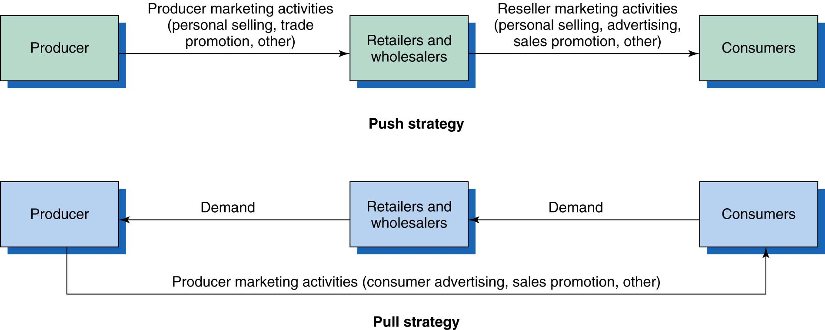
Push versus Pull Promotion Strategy

Slide 23
Fill criteria 4 Cs
Communication effectiveness
Cost
Control
Credibility

Slide 24
Characteristics of promotional tools - Communications
 | Advertising | Sales Promotion | Public Relations | Personal Selling | Direct Marketing
Ability to deliver a personal message | Low | Low | Low | High | High
Ability to reach a large audience | High | Medium | Medium | Low | Medium
Level of interaction | Low | Low | Low | High | High
Credibility given by target audience | Low | Medium | High | Medium | Medium

Slide 26
Types and reasons for advertising
Advertising products and services …McDonanld’s
Advertising ideas…. Greenpeace and Oxfam
Advertising people …. President

Slide 29
Communications models
DRIP model:
D Differentiate
R Remind
I Inform
P Persuade

Slide 30
AIDA
Attention
Interest
Desire
Action

Slide 31
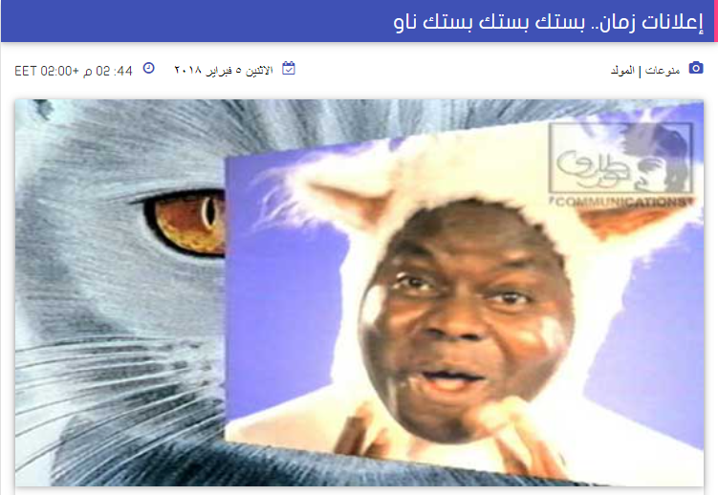

Slide 32


Slide 33
Advertising Message
High
involvement
Rational product attribute appeals
Information provision Benefit claims
Emotional image-based appeals
Social, ego, hedonic orientation
Low
involvement

Slide 34


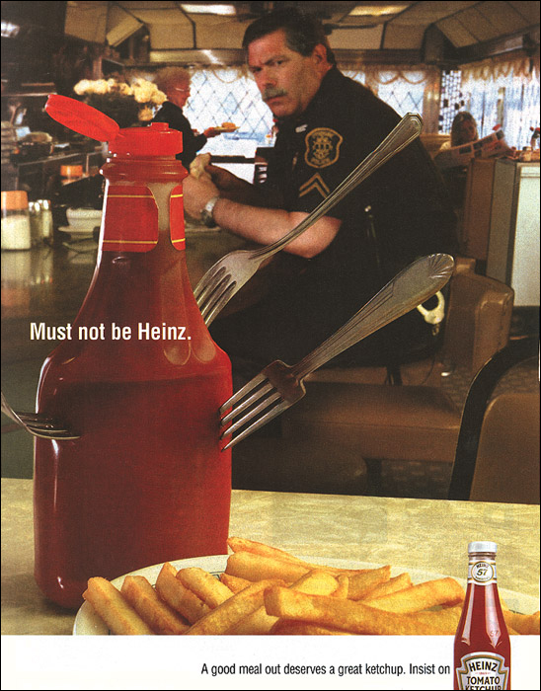
Clever Ads Encourage Low
Involvement Learning
Notes:
Relation to text
This slide relates to material on p.152 of the text.
Summary Overview
This slide shows one of the ads from the “Insist on Heinz” campaign for Heinz ketchup. This ad can be used as an example of advertising for a low involvement product and the low involvement hierarchy. Advertisers of low involvement products often repeat simple product claims such as a distinctive feature or benefit. Heinz has dominated the ketchup market for years by repeatedly telling consumers that its brand is the thickest and richest and the highest quality. The company has used a variety of ad campaigns over the years; however, they have always communicated the same basic message of product quality. This ad features a police officer sitting in a restaurant and staring at an off-brand ketchup bottle punctured with forks. The headline reads: “Must not be Heinz.” The copy at the bottom of the ad encourages consumers to insist on Heinz when they eat out.
Use of this slide
This slide can be used to show an example of a low involvement product advertisement. Heinz has been consistent through the years in reminding the consumer they are the best and most preferred brand of ketchup. Because it is a low involvement product, Heinz has used clever advertising emphasizing product attributes and a heavy repetition schedule for its advertising.

Slide 35
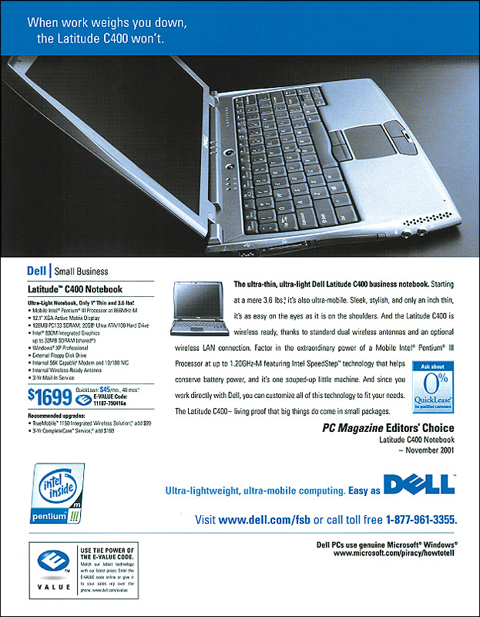
Computers are high-involvement, highly differentiated products
© 2003 McGraw-Hill Companies, Inc., McGraw-Hill/Irwin
Notes:
Relation to text
This slide relates to material on p.150-151 of the text.
Summary Overview
This slide shows an ad for Dell Computers and is an example of advertising for a high involvement, highly differentiated product. Ads for high involvement products such as personal computers provide customers with detailed information that can be used to evaluate brands, form attitudes and help them make a purchase decision.
Use of this slide
This slide can be used as an example of advertising for a high involvement, highly differentiated product. Consumers purchasing a computer are likely to follow a standard learning hierarchy where they learn about the product, form feelings or attitudes, and then make a purchase. In this hierarchy the consumer is generally an active participant and gathers information. As such, the advertisement includes information the consumer can use to make an informed purchase decision.

Slide 36
Public relations
The planned and sustained effort to establish and maintain goodwill and mutual understanding between an organization and its publics

Slide 37
PR people
PR people are often ex-journalists who have some contacts with the news media and who know how to create a story that will be printed in the way the company wants it to be done

Slide 38
Publicity
Unpaid communication about an organization appearing in the mass media
Non personal paid ------ advertising
Personal non paid ------- personal selling
Non personal non paid ----- publicity

Slide 39
Public relations
Corporate image :
How a company is perceived by its publics
Corporate identity:
Relates to logos , preferred colors …..

Slide 40
Public relation activities
Press release & video news release
Press conferences
Sponsorship
Exhibitions
Corporate social responsibility
Corporate literature
Corporate hospitality
Videos
Special events “celebrity store openings”
Website

Slide 41
Major Public Relations Tools
News
Web Site
Speeches
Public Service Activities
Special Events
Corporate Identity Materials
Written Materials
Audiovisual Materials

Slide 42
Press conference
-Used for very high profile product launches
-Also it can be used as a tool for crisis management

Slide 43
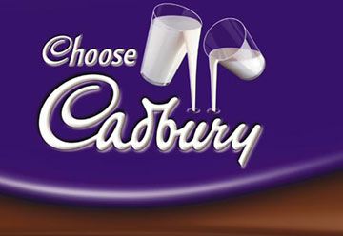
Development of corporate image
Includes logo , branding , corporate badge ...
It is a tool for differentiation between competing companies
e.g. Cadbury “The first name in chocolate”

Slide 44
Corporate social responsibility
It is the obligation of the organization to increase its positive effects and decrease its negative effects on the society
Should be related to the field of business in which we operate
e.g. Avon & its campaign in breast cancer

Slide 45
Corporate people
-It is good to select them from a field relevant to the character of the industry
e.g. Proctor & Gamble and Dr Mohamed Refeat

Slide 46
Newsworthy
Interesting (relevant to readers)
Local (relevant to the area/region )
Topical (happening now)
Important (have an impact on readers)

Slide 47
Planning an effective PR campaign
PASS model
+
Budget
+
Evaluation

Slide 48
Steps in Developing Effective Communications
Identify target audience
Determine objectives
Design communications
Select channels
Establish budget
Decide on media mix
Measure results/ manage IMC

Slide 49
Measuring PR activities
Haywood suggested commonly used measures of results:
1-Budget:
an assessment of whether the planned PR activity has been achieved within the budget or not
2-Awareness:
through a range of marketing research activities
3-Attitude

Slide 50


Slide 51


Slide 52
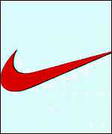

Slide 53
Logo
-Basic tool for building corporate image
-Must have attractive colors
Objectives
-Attractive attention
-Create impression
-Create recognition
-Give information

Slide 54
Mechanism / message of logo
1-Symbolic :
-representing the activity , name of the organization e.g. Shell - Hyundai
2-Expressive:
-Creating impression relevant to the organization e.g. Nike
3-Recognizable
-Creating identification e.g. Vodafone

Slide 55


Slide 56
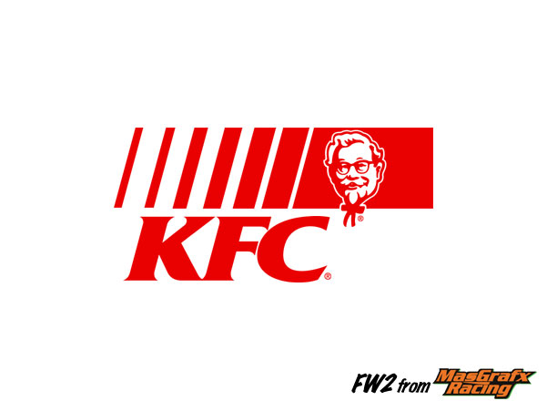

Slide 57
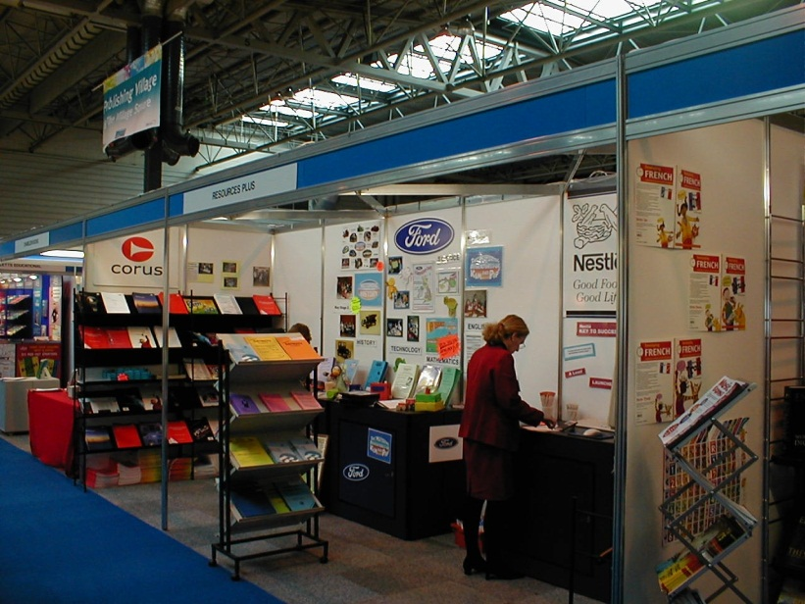
Exhibitions
-Here customers come to see the supplier
-Visitors are usually from the same industry
-Are hold in large halls with large stands
-Its cost is rising

Slide 58
Exhibitions
Purposes
Public relations
Promotion and selling
Networking
Testing the response

Slide 59
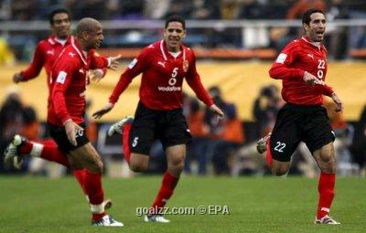

Sponsorship
It is an agreement between a company and an event organizer where the company gives money in exchange for rights to associate the company name with the event

Slide 60
Sponsorship
Objectives:
-Awareness creation
-Media coverage by the sponsored event
-Association with prestigious event
-Opportunity for corporate hospitality
-Internal employee motivation

Slide 61
Sales Promotion
It is one of the promotional tools used to add value for a product or service on the short run

Slide 62
Rapid Growth of Sales Promotion
Sales promotion can take the form of consumer promotions, business promotions, trade promotions, or sales force promotions.
Rapid growth in the industry has been achieved because:
  Product managers are facing more pressure to increase their current sales,
  Companies face more competition,
  Advertising efficiency has declined,
  Consumers have become more deal oriented.

Slide 63
Sales Promotion Objectives
Consumer Promotions:
increase short-term sales or help build long-term market share.
Trade Promotions: get retailers to:
  carry new items and more inventory,
  advertise products,
  give products more shelf space, and
  buy product ahead.

Slide 64
Sales Promotion/ types
B2B intermediary
B2C consumer

Slide 65
B2C sales promotion
BOGOF
Discount
Samples
Gift with purchase
Contest
Sweepstake
Loyalty program

Slide 66
B2B sales promotion
Bonus
Discount
Loyalty program

Slide 67
Major Consumer Sales Promotion Tools
Sample
Trial amount of a product
Coupons
Savings when purchasing specified products
Cash Refunds
Refund of part of the purchase price
Price Packs
Reduced prices marked on the label or package
Premiums
Goods offered free or low cost as an incentive to buy a product
Advertising
Specialties
Articles imprinted with an advertiser’s name given as gifts

Slide 68
Major Consumer Sales Promotion Tools
Patronage Rewards
Cash or Other Award Offered for Regular Use of a Product
Point-of-Purchase
Displays or Demonstrations at the Point of Purchase
Contest
Consumers Submit an Entry to be Judged
Sweepstakes
Consumers Submit Their Names for a Drawing (by chance)
Games
Consumers Receive Something Each Time They Buy Which May Help Them Win a Prize

Slide 69
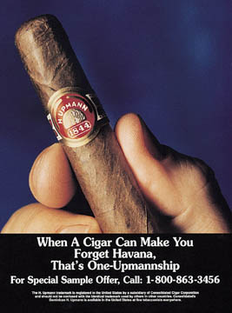
Sampling is an Effective
Way to Create Trial-Use
Within Appropriate
Target Markets

Slide 70
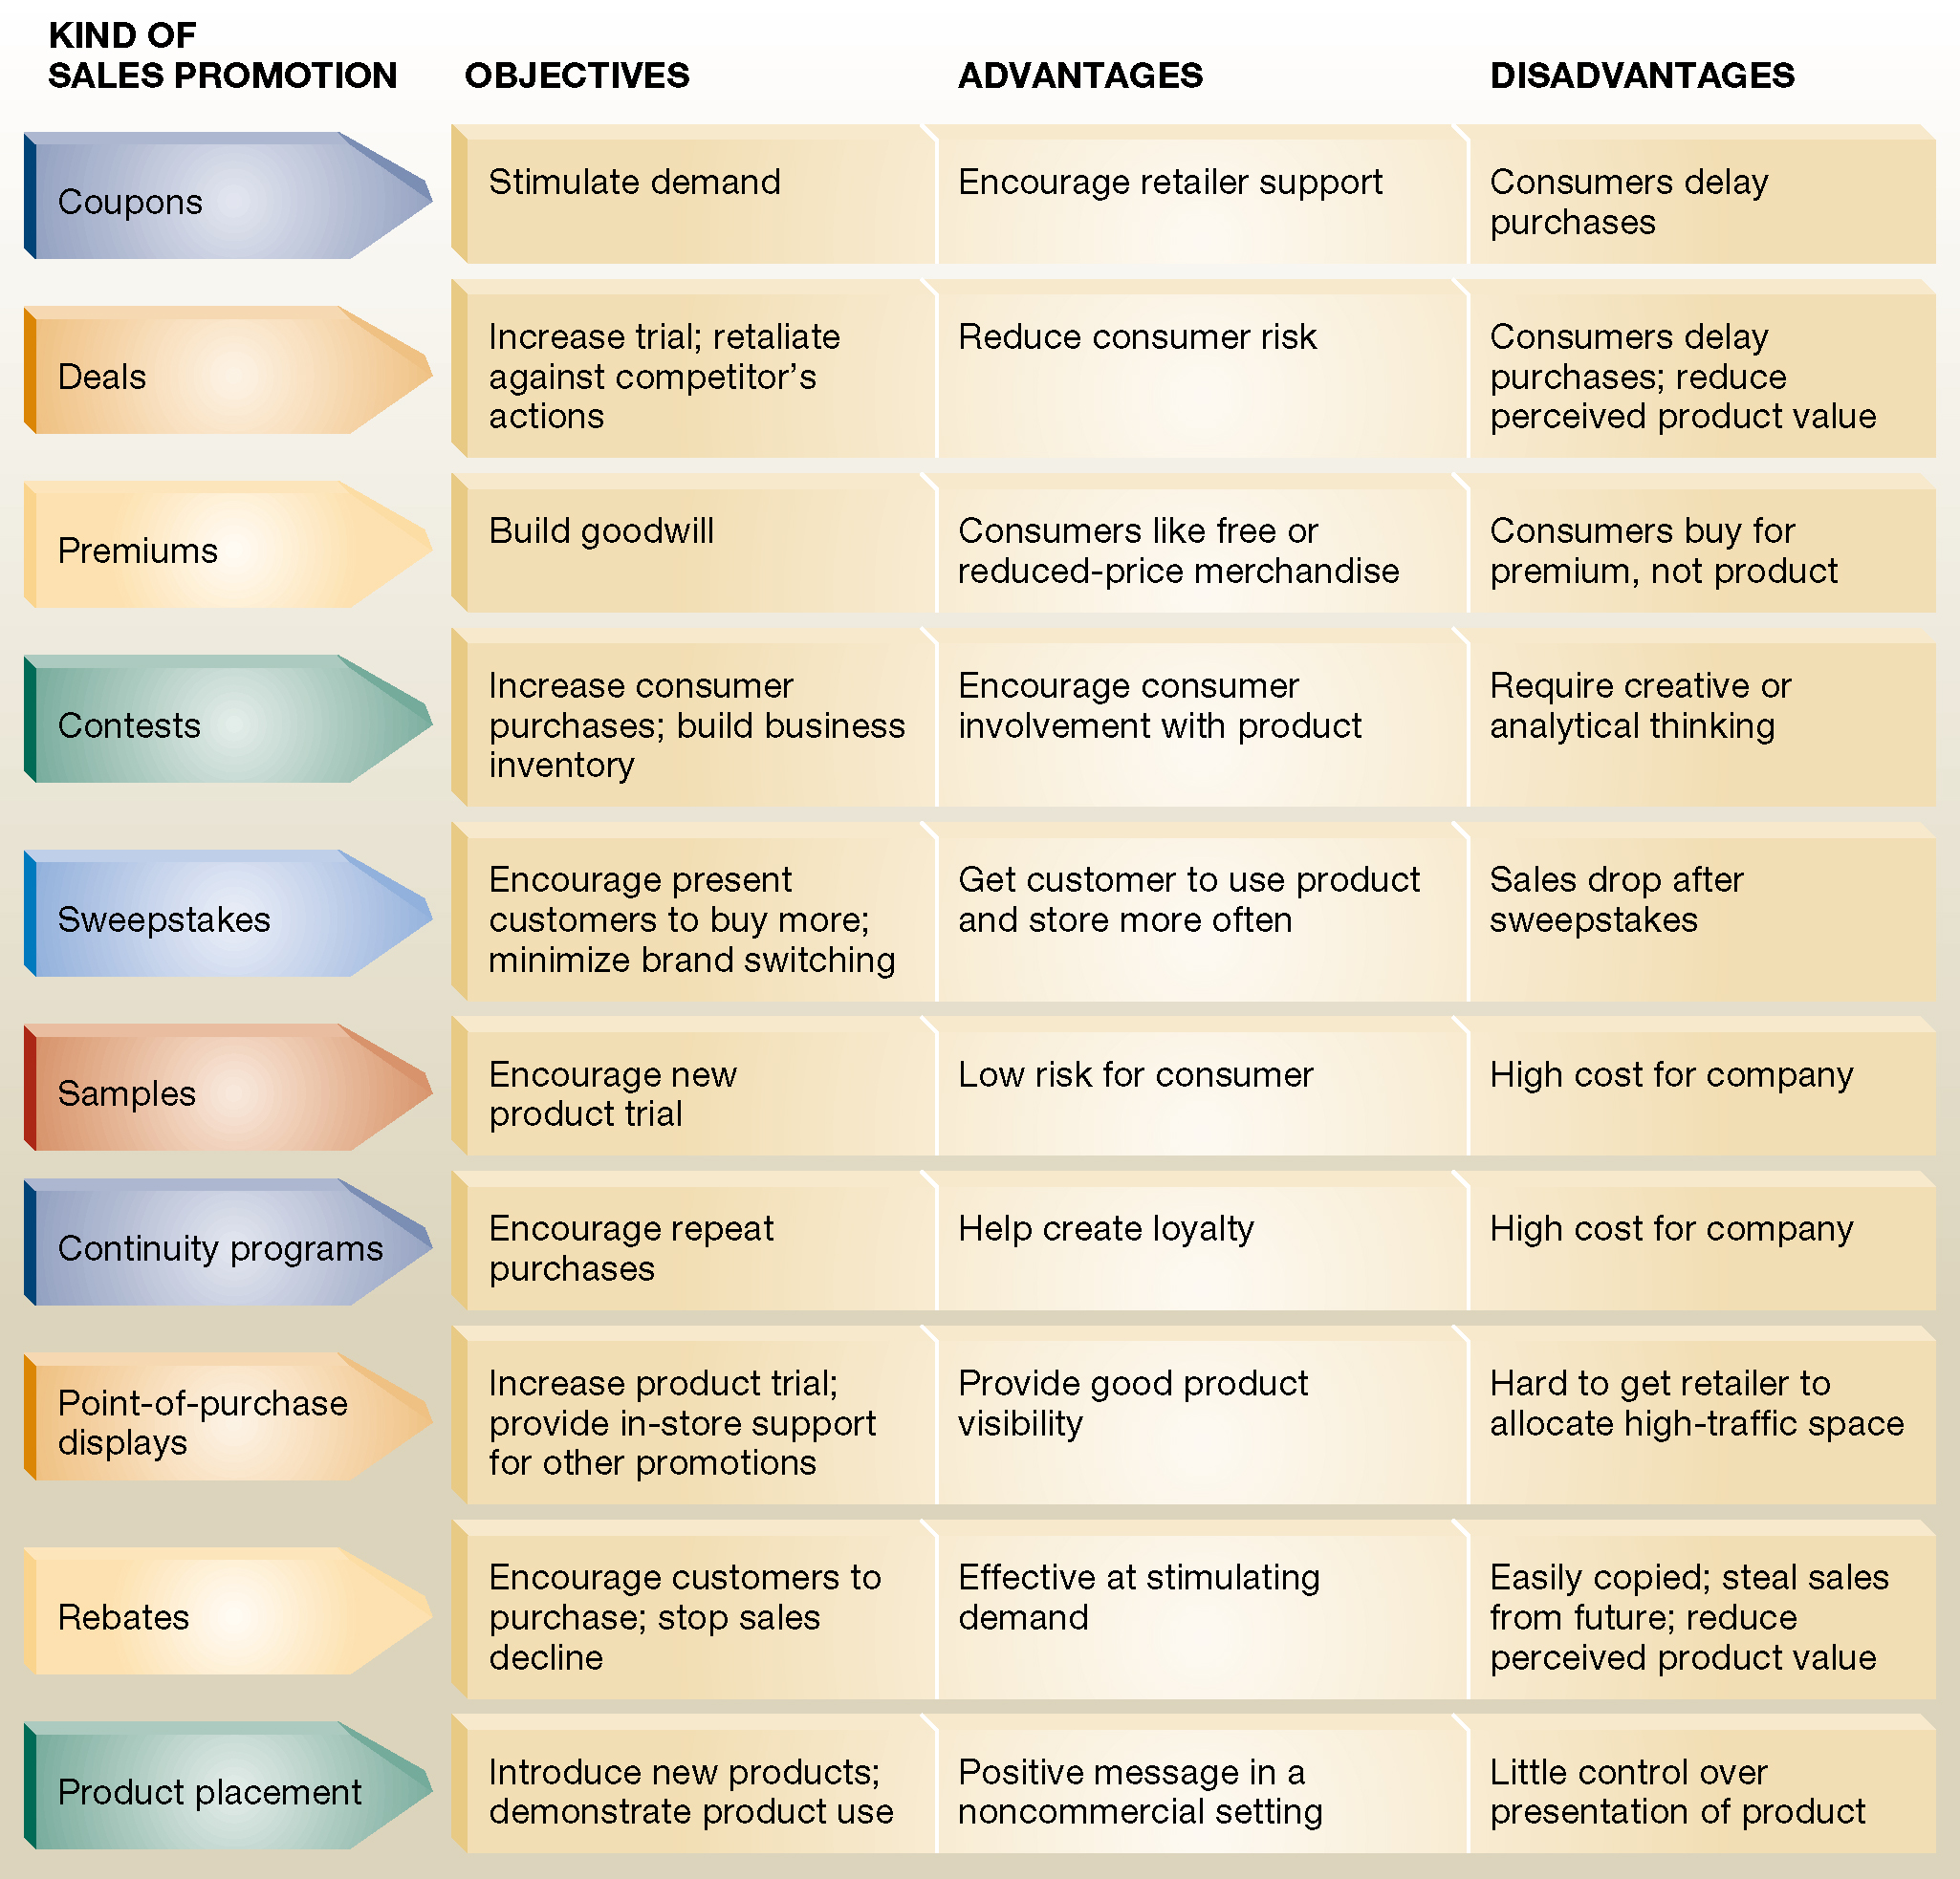
Sales promotion alternatives

Slide 71
Major Trade Sales Promotion Tools
Trade-Promotion Objectives
Trade-Promotion Tools
Persuade Retailers or
Wholesalers to Carry a Brand
Discounts
Give a Brand Shelf Space
Allowances
Promote a Brand in
Advertising
Free Goods
Push a Brand to Consumers
Push Money
Specialty Ad Items

Slide 72
Major Business Sales Promotion Tools
Business-Promotion Objectives
Business-Promotion Tools
Generate Business Leads
Conventions
Stimulate Purchases
Trade Shows
Reward Customers
Sales Contests
Motivate Salespeople

Slide 73
Developing the Sales Promotion Program
Decide on the Size of the Incentive
Set Conditions for Participation
Determine How to Promote and
Distribute the Promotion Program
Determine the Length of the Program
Evaluate the Program

Slide 74
Evaluation of sales promotion
1-Consumer audits:
This will indicate if there has been a change in consumer behavior
2-Retail audits:
Change in stock levels , distribution & market share
3-Sales force feedback
4-Sales information

Slide 75
Sales promotion
As promotional manager of a well established UK manufacturer of women’s beauty products explain how you would use sales promotion to support the national launch of “Chico”. This is a new fragrance targeted at B,C1, 18-45 women who are prepared to try a new perfume
(12 marks)

Slide 76
Answer guidelines
Definition of sales promotion
Types of sales promotion
The objective of sales promotion in this case is :
“ to stimulate the trial of Chico by our target consumers”
Techniques:
-Free sample attached to a monthly magazine
-Coupons “the first 200 women will win full size bottle”
Designing of the campaign:
-Timing :the stores should have adequate stocks of Chico
it should coincide with the above line advertising
Image: any direct price promotions would cheapen the image of Chico
Evaluation:
the number of responses to coupons
comparison of sales before and after
Chico market share
Survey

Slide 77
Two-thirds of purchases result from in-store decisions

Slide 78
Point of sale display ( POS)
-It refers to the in store display that can influence consumers to purchase products in shops
It includes:
-Shop layout and design
-The way goods are presented
-In store display materials

Slide 79
POS materials -Dandy Egyptian Swiss

Slide 81
Poster

Slide 82

Dangler

Slide 83
Dangler

Slide 84

Flyer

Slide 85
Shelf talker

Slide 86
Wobbler

Slide 87
Flags

Slide 88


Slide 89
Packaging
5 key functions:
Protection
Distribution
User convenience
Promotion
compliance

Slide 90
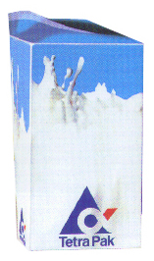
Packaging
Tetra Pak provides an example of the power of innovative packaging and customer thinking.
Tetra Pak invented an aseptic package that enables milk , fruit juice and other perishable liquid foods to be distributed without refrigeration, so dairies can distribute milk over a wider area without investing in refrigerated trucks and facilities. Supermarkets can carry Tetra Pak packaged products on ordinary shelves allowing them to save expensive refrigerator space

Slide 91
Personal Selling
It is personal paid promotional tool in which there is a face to face contact between a company representative and a customer
Selling process /Sales call

Slide 92
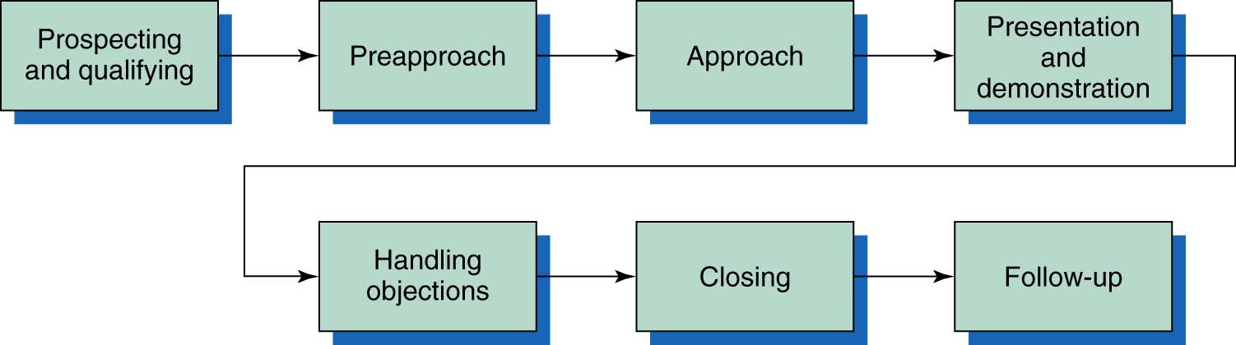
Major Steps in Effective Selling

Slide 93
Advantages of personal selling
It contributes to a relatively high level of customer attention
Message customization
Two ways communications allows immediate feedback
It is an opportunity to develop long term relations
Using visual elements

Slide 94
Disadvantages of personal selling
The main disadvantage is the cost as a salesperson can only interact with one buyer at a time
The control on the message is limited

Slide 95
Direct marketing
-The planned recording ,analysis and tracking of customer behavior to develop relational marketing strategies
-It creates and develop direct one to one relationships
-To carry out direct marketing you need Databases

Slide 96
Tools of direct marketing
Direct mail (mail shots) “most common”
E-mail
Mobile phone text messaging (SMS)
Direct response advertising
Catalogue marketing /brochures / website
Call centers and telemarketing
“V-Reps “ : Virtual Reps
Door drops
E-commerce

Slide 97
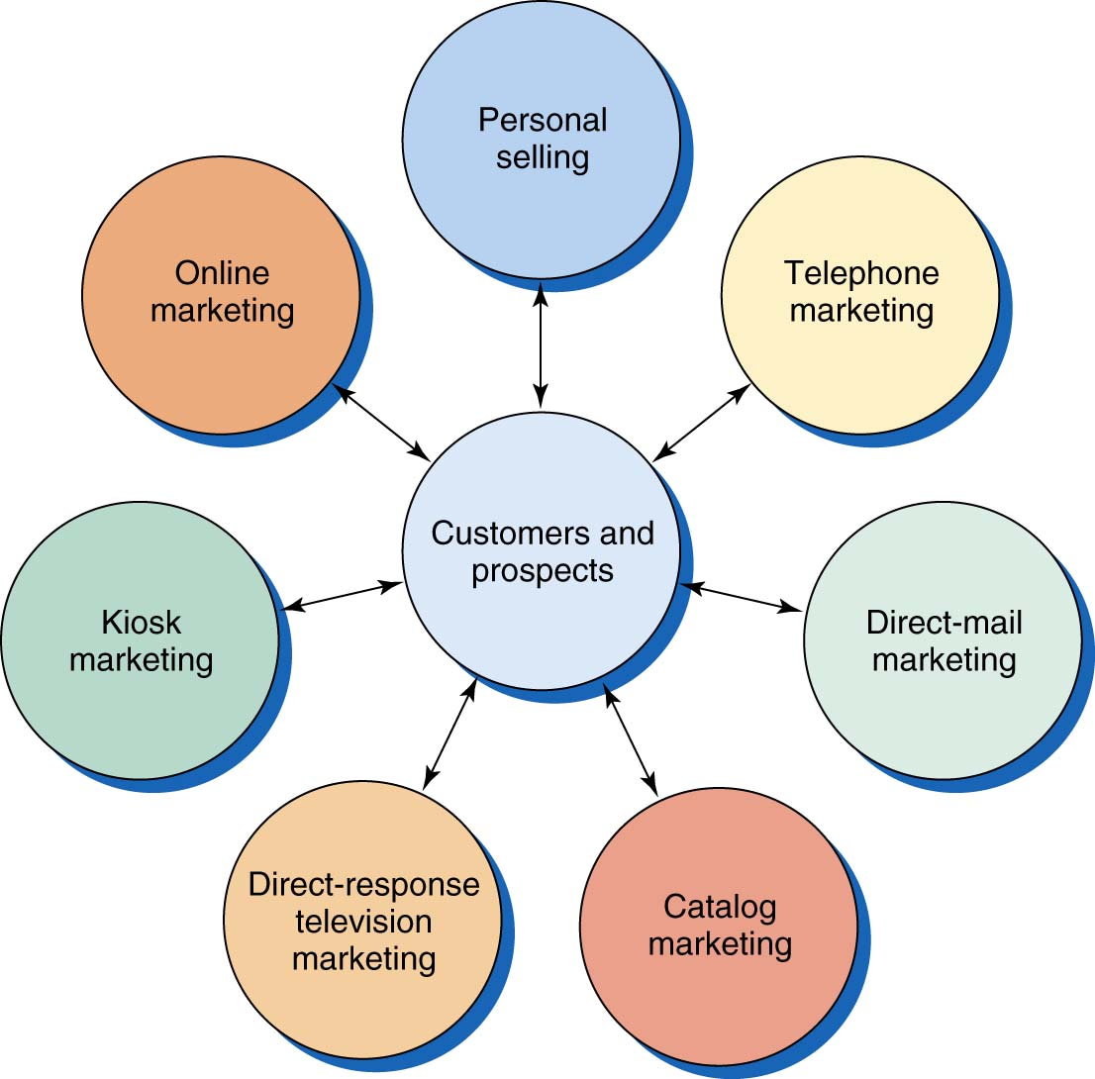
Forms of Direct Marketing

Slide 98
Forms of Direct Marketing
Telephone Marketing
  Represents 36% of direct marketing sales.
  Telephone marketing sells directly to customers.
Direct-Mail Marketing
  Represents 31% of direct marketing sales.
  High target-market selectivity.
  Personalized & flexible.
  Allows easy measurement of results.
  Fax mail, e-mail, voice mail are now popular

Slide 99
Forms of Direct Marketing
Catalog Marketing
  Sales expected to exceed $94 billion by 2002.
  Printed catalogs remain the primary medium, but many are now electronic.
Direct-Response TV Marketing
  Direct-response advertising
Kiosk Marketing
  Placing information and ordering machines at various locations.

Slide 100
Advantages of Direct Marketing
Benefits to Sellers
  Consumer relationship building
  Reduces costs
  Increases speed and efficiency
  Provides flexibility
  Global medium
Benefits to Buyers
  Convenient
  Easy to use
  Private
  Product access and selection
  Abundance of information
  Immediate
  Interactive

Slide 101
Disadvantages of direct marketing
1- Regarded as intrusive by many
2- Data processing costs can be high

Slide 102
Exam question
A- Using a consumer product or service of your choice ,identify and comment upon each stage involved in planning a promotional campaign.? (10 marks)
B-Why might the selection of promotional tools differ for an industrial product ? (10 marks)

Slide 103
Chapter 8
Advertising

Slide 104
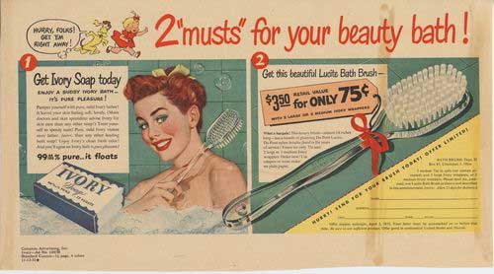
Procter & Gamble’s Advertising
History
Notes:
Click on the video icon to launch a video clip about Procter & Gamble’s advertising history.

Slide 105
Advertising Execution Techniques

Slide 106
Rational advertising
Factual
Demonstration
Comparison

Slide 107
Demonstration
Headache remedies, floor cleaners and tyre commercials have traditionally demonstrated the pain, the dirt and the danger respectively, and have then shown how the focus brand relieves the pain (Panadol), removes the stubborn dirt (Flash) or stops in the wet on a coin (or the edge of a rooftop – Continental tyres).

Slide 108
Emotional advertising
Testimonial or endorsement
Animation
Music
Fear
Humor
Sex
lifestyle
Joy
Love
Pleasure
Pride
Safety
Security
Self-esteem
Combinations

Slide 109
Fear advertising
Fear is used in one of two ways. The first type demonstrates the negative aspects or physical dangers associated with a particular behavior or improper product
usage.
Drink-driving, life assurance and toothpaste advertising typify this form of appeal.
The second approach is the threat of social rejection or disapproval if the focus product is not used.
This type of fear is used frequently in advertisements for
such products as anti-dandruff shampoos and deodorants, and is used to support consumers’ needs for social acceptance and approval.

Slide 110
Animation
Animation techniques have advanced considerably in recent years, with children as the prime target audience. However, animation has been successfully used in many adult-targeted advertisements, such as those by Schweppes, Compaq, Tetley Tea, Direct Line Insurance and the Electricity Board.
The main reason for using animation is that potentially boring and low-interest/involvement products can be made visually interesting and provide a means of gaining attention.
A further reason for the use of animation is that it is easier to convey complex products in a way that does not patronize the viewer.

Slide 111
Sex advertising
Sex appeals normally work well for products such as perfume, clothing and jewellery but provide for poor effectiveness when the product is unrelated, such as cars, photocopiers and furniture.
The use of sex in advertising messages is mainly restricted to getting the
attention of the audience and, in some circumstances, sustaining interest. It can be
used openly, as in various lingerie, fragrance and perfume advertisements, such as
WonderBra and Escape; sensually, as in the Hنagen Dazs and Cointreau campaigns;
and humorously, as in the Locketts brand.

Slide 112
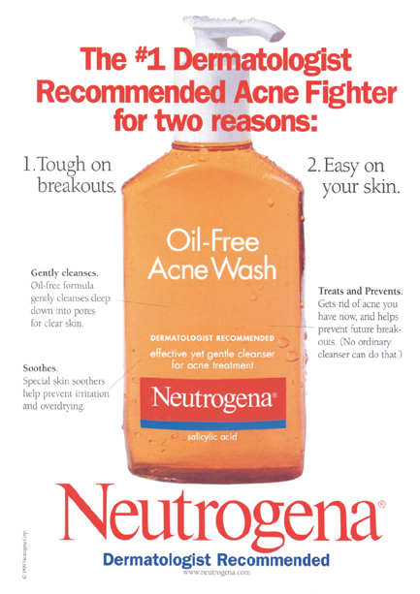

Slide 113
Factual

Slide 114
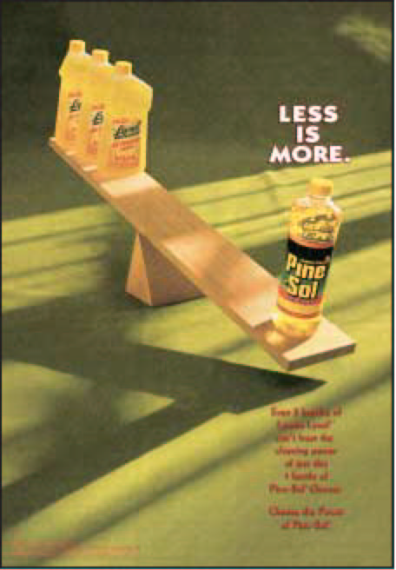

Slide 115
Comparative Advertising

Slide 116


Slide 117
Comparison.

Slide 118
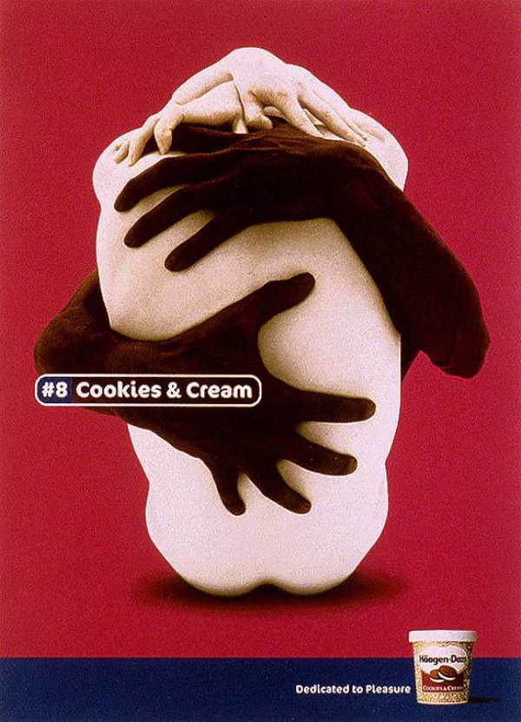
Haagen Dazs ice cream

Slide 119
Animation and Sexual
Haagen Dazs premium ice cream entered the UK market using pleasure as central to the message appeal.

Slide 120
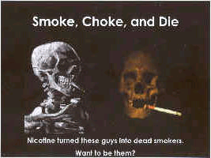

Slide 121
Fear

Slide 122
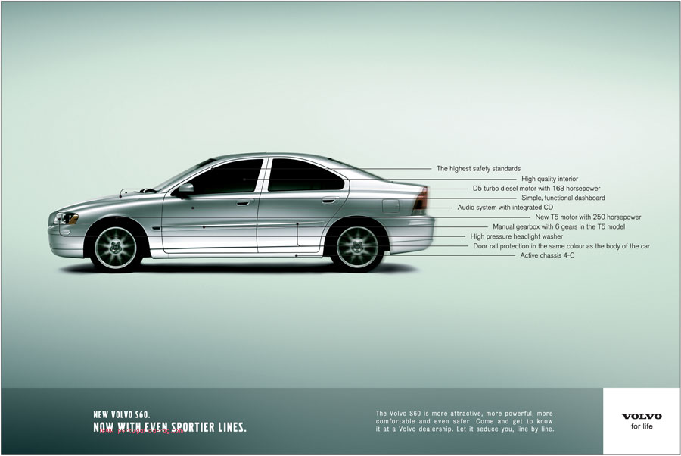
Volvo ad

Slide 123
Factual

Slide 124
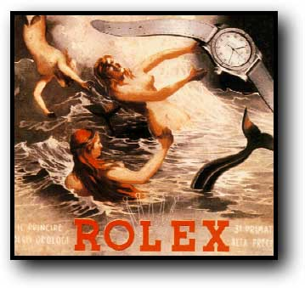
Rolex ad

Slide 125
Animation

Slide 126
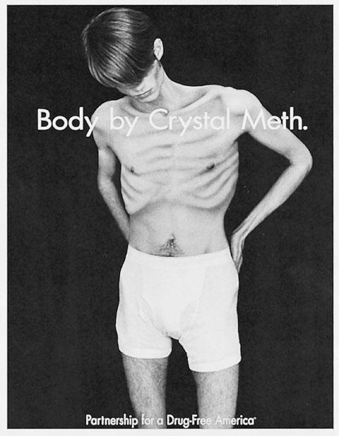
Partnership for a Drug-Free America

Slide 127
This as uses a rather extreme level of fear appeal.

Slide 128
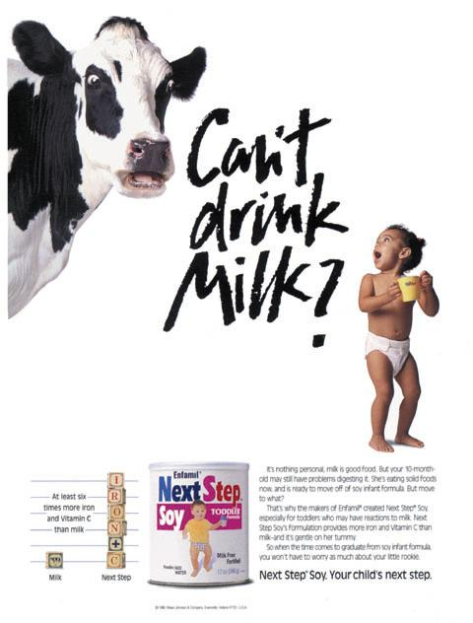
Next Step

Slide 129
This is also a bit of a comparison ad though for most consumers of this product

Slide 130
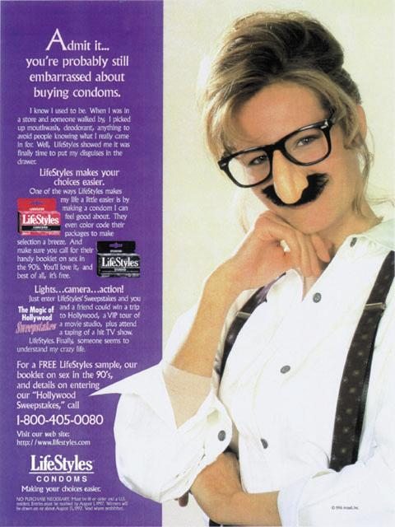
Lifestyles Condoms

Slide 131
This ad uses humor to approach a sensitive topic. It seems appropriate and well-done in this context

Slide 132

Addressing Smoking Attitudes

Slide 133
This Norwegian ad addresses young people’s smoking attitudes by arousing strong negative feelings. The ad reads (left panel) “Smokers are more sociable than others.” (Right panel): “While it lasts.”

Slide 134
Ashworth appeals

Slide 135
Lifestyle

Slide 136
Celebrity endorsement
Famous people can be effective because they are credible ,attractive or both depending on the reasons for their fame

Slide 137
Source attractiveness
Source attractiveness refers to the source’s perceived social value.
It originates from the person’s physical appearance, personality, social status, or similarity to the receiver (we like to listen to people who are like us).

Slide 138
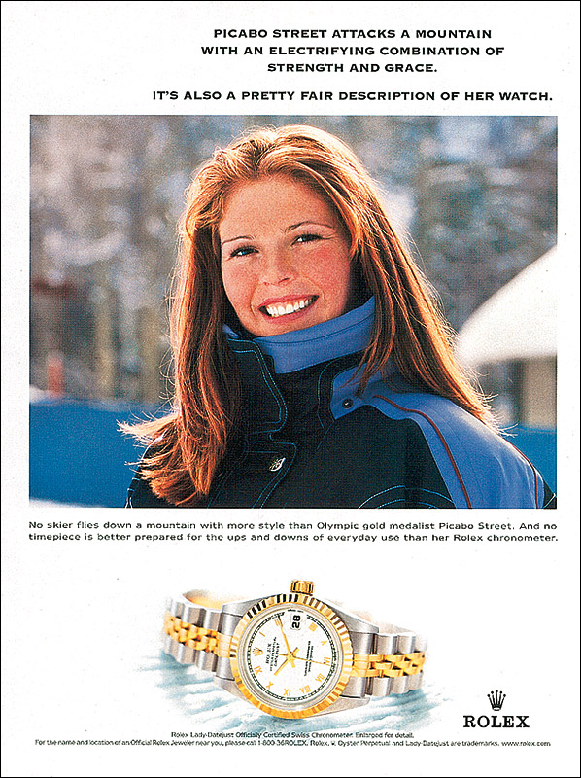
Attractive sources are appropriate for image-related products
© 2003 McGraw-Hill Companies, Inc., McGraw-Hill/Irwin
Notes:
Relation to text
This slide relates to material on p. 151 and Exhibit 5-1 of the text.
Summary Overview
The source can be an individual, such as a celebrity, or a non-personal entity such as the corporation or the organization itself. This ad is for Rolex watches and is an example of using a celebrity as the source. In this ad, Olympic skiing champion Picabo Street appears as a spokesperson for Rolex.
Use of this slide
This slide can be used to show how celebrities are often used as a source in an advertising message. Although source characteristics will be discussed in Chapter 6, this is a good opportunity to discuss how marketers must be careful in selecting a source the receiver believes is knowledgeable and trustworthy or whom the receiver finds attractive and can relate to in some manner.

Slide 139
Celebrities as communications sources
The use of celebrity endorsement is an expensive but common strategy

Slide 140
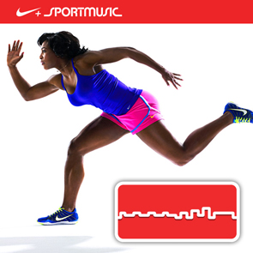
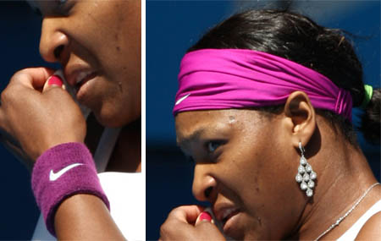
Celebrity endorsers
Nike and Serena Williams :edgy, individualistic brand

Slide 141
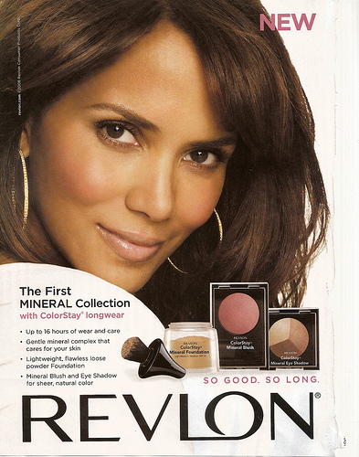
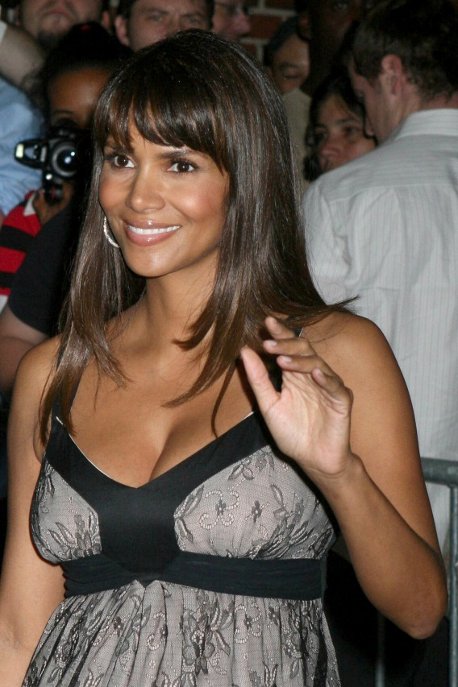
Celebrity endorsers
Revlon and Halle Berry :Sexy confident brand

Slide 142
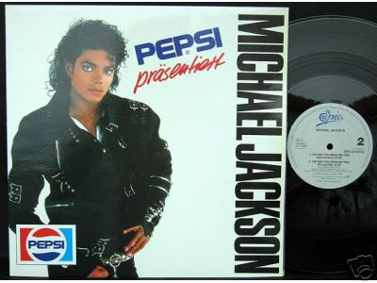
Pepsi and Michael Jackson
After Pepsi paid over $5 million to singer Michael Jackson in an endorsement deal , the company was not pleased by his later confession that he does not drink soda and cola

Slide 143
Celebrity endorsement
A recent study illustrates the social comparison process
It showed that female college students tend to compare their physical appearance with models who appear in advertising

Slide 144
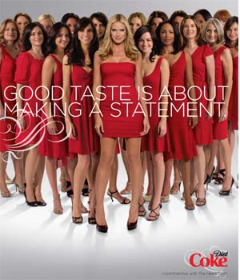
Coca-Cola ad

Slide 145
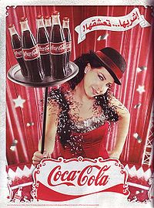
Coca-Cola ad / Nancy

Slide 146
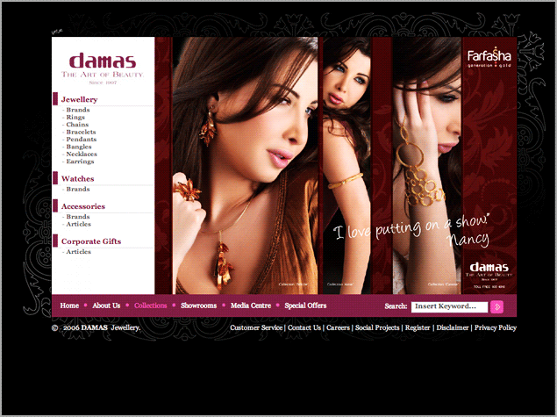

Slide 147
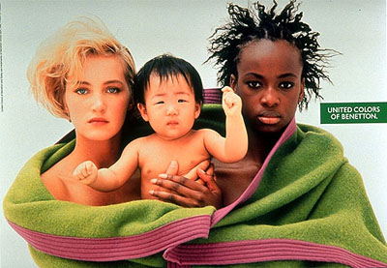
Benetton ad
As suggested by this Benetton ad a global perspective on ideals of beauty is resulting in more ways to be considered attractive

Slide 148
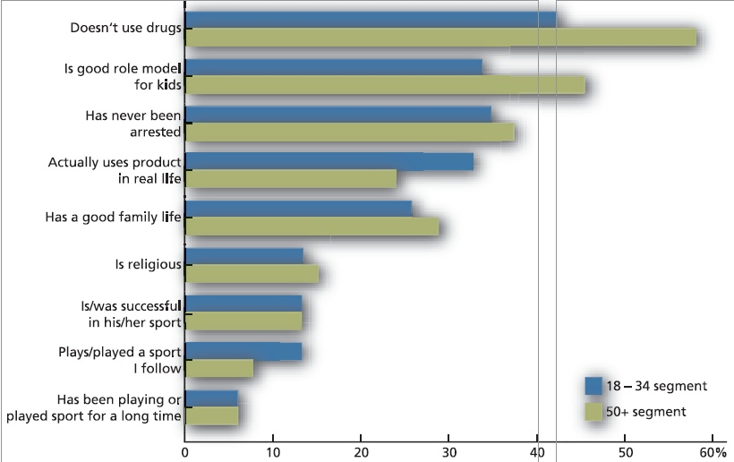
Endorser Traits
Notes:
Relation to text
This slide relates to Figure 6-3 on page 185.
Summary Overview
This slide shows the traits that consumers find important in celebrity endorsers. It is interesting to point out how the importance given each trait varies by the age of the target audience, and on which traits age has no impact.
Use of this slide
This slide can be used as part of a discussion about celebrity traits.

Slide 149
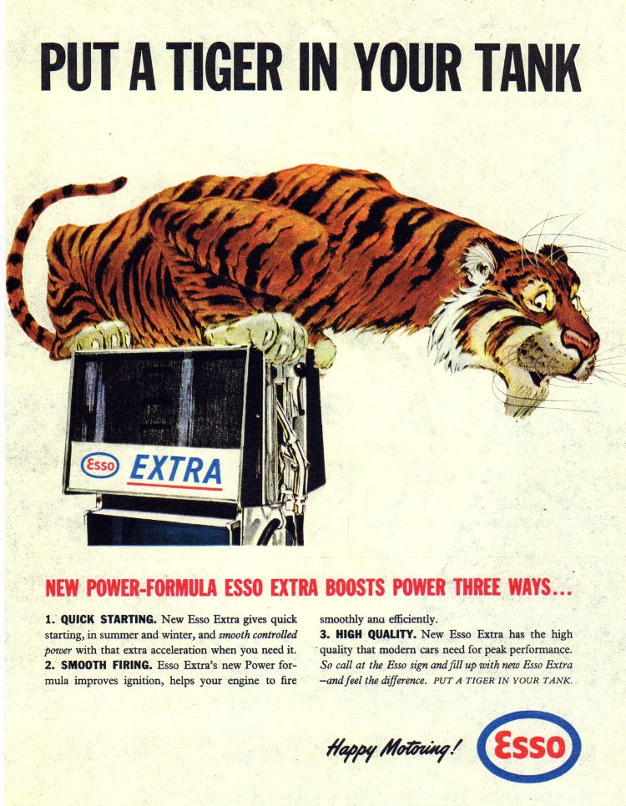

Slide 150
Esso (now Exxon)
Esso for many years reminded consumers to “Put a tiger in your tank”
People responded well to this powerful animal symbolism containing sexual undertones

Slide 151
Media scheduling patterns
Continuous pattern
Flighting patterns
Pulsing

Slide 152
Evaluating Advertising
Advertising Program Evaluation
Communication Effects
(Copy Testing)
Is the Ad Communicating
Well?
Sales Effects
Is the Ad Increasing
Sales?

Slide 153
Evaluating Advertising
1-Pre-testing :
-Focus group
2-Post-testing :
-Recognition test
-Recall test

Slide 154
Developing the advertising campaign
Identify and analyse advertising target
Define objectives
Create advertising platform
Determine budget
Develop media plan
Create advertising message
Implement campaign
Evaluate effectiveness

Slide 155
Types of media available
Broadcast - TV & Radio
Print - Newspapers & Magazines
Outdoor - Billboards & Transit
New - CD-ROM, Internet, etc
In-Store - POP & packaging
Other - Cinema, product placement, exhibitions, etc

Slide 156
Television
Disadvantages:
  Not easy to target selected audiences.
  Relatively expensive.
  Requires production specialists.
  Short exposure time.
Advantages:
  Reaches large audiences
  Visual and audio capabilities.
  Maximum flexibility for gaining attention.
  Short lead time to place ad.

Slide 157
Magazine
Advantages
  Reaches demographic and geographic segments.
  High Quality reproduction.
  Ad lasts as long as magazine is kept and read.
  Ad benefits from magazine’s credibility.
Disadvantages
  Must place ad well in advance of publication.
  Limited flexibility to gain attention.
  No complete control of location of ad in magazine.

Slide 158
Newspaper
Advantages
  Reaches large audience.
  Segments audiences by locale.
  Short lead time to place ad.
  Credibility of newspaper can benefit ad.
Disadvantages
  May be expensive.
  Little flexibility for creative messages.
  Limited reproduction quality (eg. Use of colour).
  Short life of newspaper carries over to ad.

Slide 159
Outdoor
Advantages
  Relatively inexpensive.
  Many repeat exposures for one appearance
Disadvantages
  Only a very limited message is possible.
  Cannot segment audience.
  Very short exposure time..

Slide 160
Radio
Advantages
  Audio capabilities.
  Relatively low costs.
  Short lead time to place ad.
  Segments audiences demographically and geographically.
  Reaches large audiences.
Disadvantages
  No visual capabilities.
  Short exposure time.
  Little flexibility to gain attention.

Slide 161
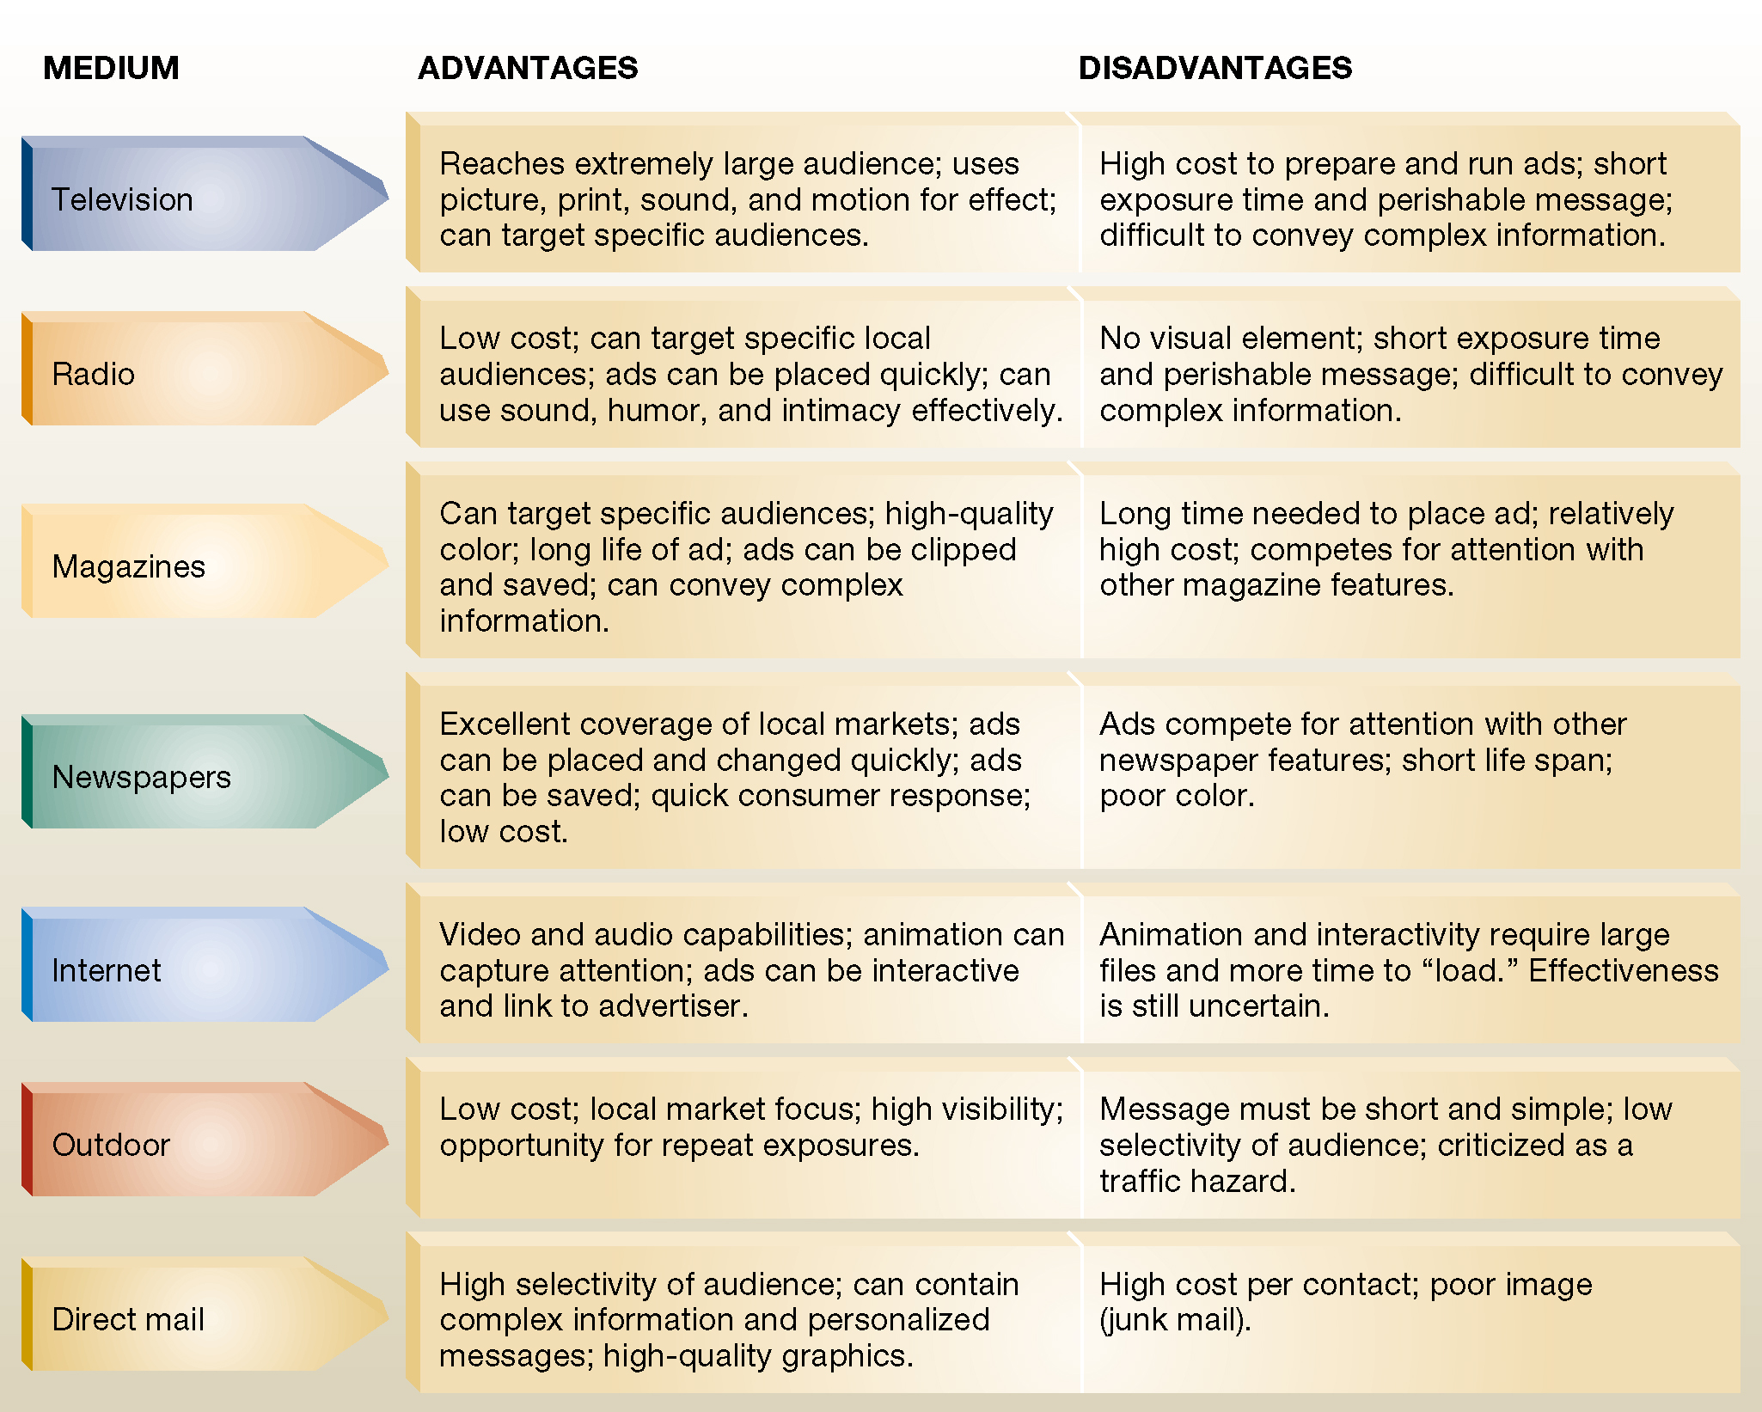

Slide 162
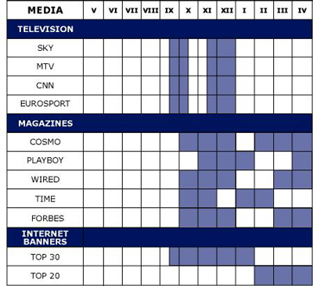
Media Selection

