Slide 2
Business Research Methodology By: Dr. Ashraf Shaarawy

Slide 3
Course Objectives
Research and the Research Process
Critical Appraisal of Literature Review
Research Methods (Quantitative and Qualitative)
Research Design
Critical Appraisal of different Research Methods
Data Analysis and Interpretation
Research Ethics and Integrity

Slide 4
ASK
A
(Attitudes)
S
(Skills)
K
(Knowledge)
What do we know?

Slide 5
ASK
A
(Attitudes)
S
(Skills)
K
(Knowledge)
What do we like and/or dislike

Slide 6
ASK
A
(Attitudes)
S
(Skills)
K
(Knowledge)
Can we perform the job efficiently

Slide 7
Chapter 1
Introduction to Research
7

Slide 8
PROBLEM SOLVING PROCESS
Define
Collect Information
Analyze
Generate Alternatives
Select Alternatives
Decide & Implement
Evaluate

Slide 9
Types of Knowledge
Traditional knowledge is a form of knowledge that we inherit from the culture we grew up in.
Authority is a form of knowledge that we believe to be true because its source is authoritative.
Experiential knowledge can be gained through pleasant /unpleasant experiences and continues throughout life
Scientific knowledge, on the other hand, is based on studies conducted by researchers. In a nutshell, scientific knowledge is knowledge we can trust.

Slide 10
Definition of Business Research
Business research: an organized, systematic, data-based, critical, objective, scientific inquiry or investigation into a specific problem, undertaken with the purpose of finding answers or solutions to it.
A process of determining, acquiring, analyzing, synthesizing, and disseminating relevant business data, information, and insights to decision makers in ways that mobilize the organization to take appropriate business actions that, in turn, maximize business performance

Slide 11
The Business Research Process
Problem Definition
Literature Review
Hypothesis
Data Collection
Data Analysis
Conclusion

Slide 12
Applied versus Basic Research
Basic research: generates a body of knowledge by trying to comprehend how certain Phenomena that occur in organizations can be described or analyzed.
Applied research: solves a current Problem faced by the manager in the work setting, demanding a timely solution.

Slide 13
Examples of Research Areas in Business
Absenteeism
Communication
Motivation
Consumer decision making
Customer satisfaction
Budget allocations
Organizational Performance

Slide 14
Why managers should know about research
Being knowledgeable about research and research methods helps professional managers to:
Identify and effectively solve problems in the work setting.
Know how to discriminate good from bad research.
Appreciate the multiple influences and effects of factors on a situation.
Take calculated risks in decision making.
Relate to hired researchers and consultants more effectively.
Combine experience with scientific knowledge while making decisions.

Slide 15
The Manager–Researcher Relationship
Each should know his/her role
Trust levels
Value system
Acceptance of findings and implementation
Issues of inside versus outside researchers/consultants

Slide 16
Internal Researchers
Advantages:
Better acceptance from staff
Knowledge about organization
Would be an integral part of implementation and evaluation of the research recommendations.
Disadvantages
Less fresh ideas
Power politics could prevail
Possibly not valued as “expert” by staff

Slide 17
External Researchers
Advantages
Divergent and convergent thinking
Experience from several situations in different organizations
Better technical training, usually
Disadvantages
Takes time to know and understand the organization
Rapport and cooperation from staff not easy
Not available for evaluation and implementation
Costs

Slide 18
Chapter 2
Scientific Investigation,
Thinking like a Researcher
18

Slide 19
1.Organization
Sole/ LLC/ Corporate
5. Geographical
2.Management Function :
Planning
Organizing
Leading
Controlling
4. Business Function
6. Industry
Sector
3. Organizational level
Executives
7. External Environment
P.E.S.T
Seniors
Experience/ knowledge
R&D
Products/ Service
Human Resources
Marketing/ Sales
Information Technology
Middle & frontline managers
Finance & Accounting
8. Internal Environment
Customers
Suppliers
Employee
Stakeholders
Workers
9. Time
9 Element model Developed By Dr Ashraf Elsafty

Slide 20
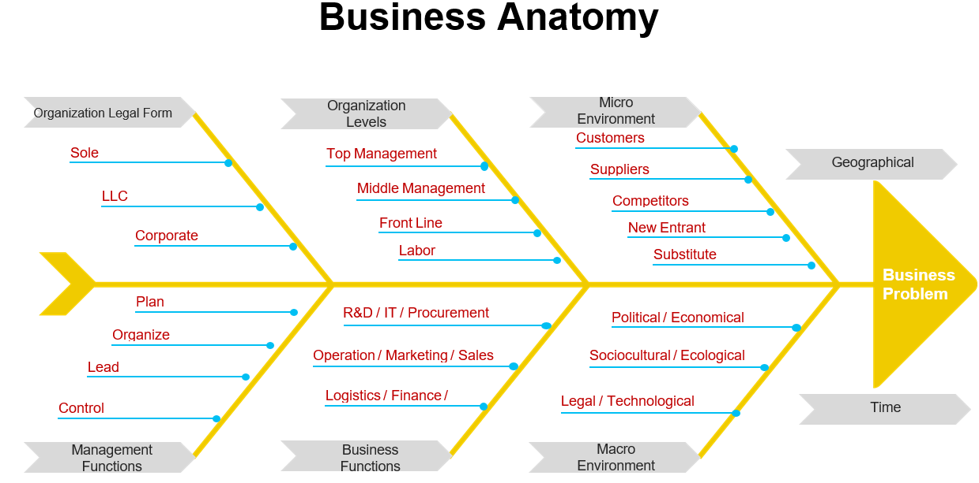

Slide 21
Activity 1
Suggest Problem that you face in your company and determine its possible causes using the model above.

Slide 22
Language of Research
Concepts
Constructs
Variables
Models
Operational
definitions
Terms used
in research
Theory
Propositions/
Hypotheses

Slide 23
Constructs and Concepts
Concepts have progressive levels of abstraction. Some concepts such as a person’s weight are precise and objective, while others such as a person’s personality may be more abstract and difficult to visualize.
Construct may be a simple concept, such as a person’s weight, or a combination of a set of related concepts such as a person’s communication skill, which may consist of several underlying concepts such as the person’s vocabulary, syntax, and spelling.
Variable is a measurable representation of an abstract construct. constructs are not directly measurable, and we look for proxy measures called variables. intelligence is a construct, and IQ score is a variable that measures the intelligence construct.

Slide 24
Constructs and Concepts Abstraction
Communication
Body Language
Voice Tone
Wording
Facial Expressions
Gestures

Slide 25
Theory and Model
A theory is a set of systematically interrelated constructs and propositions intended to explain and predict a phenomenon or behavior of interest, within certain boundary conditions and assumptions. Essentially, a theory is a systemic collection of related theoretical propositions.
A model is a representation of all or part of a system that is constructed to study that system (e.g., how the system works or what triggers the system). While a theory tries to explain a phenomenon, a model tries to represent a phenomenon.

Slide 26
A Variable Is the Property Being Studied
Event
Action
Variable
Characteristic
Trait
Attribute

Slide 27
Deduction and Induction
Deductive reasoning: application of a general theory to a specific case.
Hypothesis testing
Inductive reasoning: a process where we observe specific phenomena and on this basis arrive at general conclusions.
Counting white swans
Both inductive and deductive processes are often used in research.

Slide 28
Sound Reasoning
Argument
Deduction
Induction

Slide 29
Deductive Reasoning
Inner-city household interviewing is especially difficult and expensive
This survey involves substantial inner-city household interviewing
The interviewing in this survey will be especially difficult and expensive
© 2002 McGraw-Hill Companies, Inc., McGraw-Hill/Irwin
Notes:
This slide provides an example of a deductive argument.

Slide 30
Inductive Reasoning
Why didn’t sales increase during our promotional event?
Our retailers did not have sufficient stock to fill customer requests during the promotional period
A strike by employees prevented stock from arriving in time for promotion to be effective
COVID closed retail outlets in the region for 2 months during the promotion

Slide 31
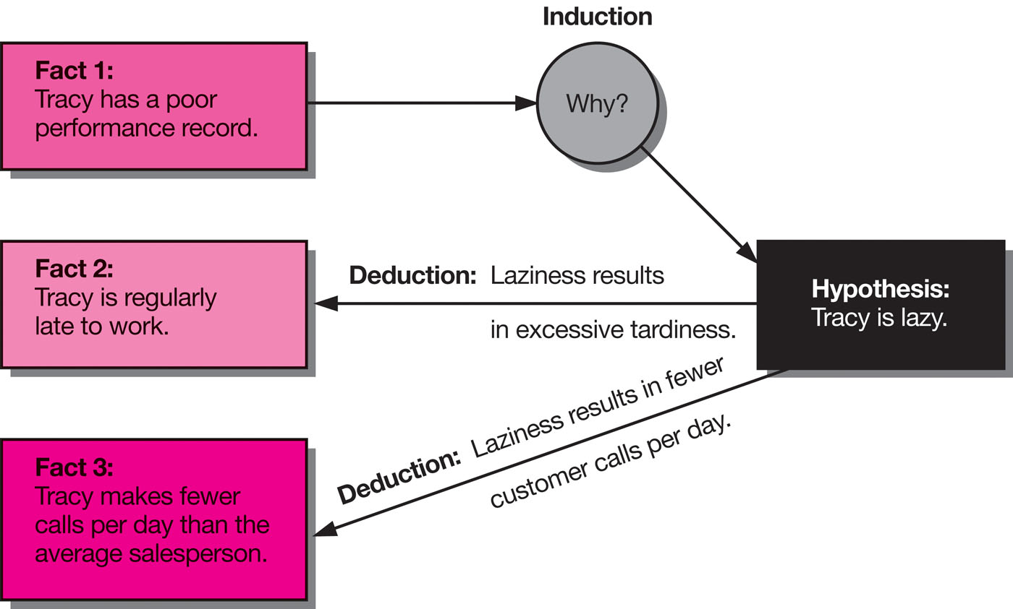
Employee’s Performance

Slide 32
Hypothetico-Deductive Research
The Seven-Step Process in the Hypothetico-Deductive Method
Identify a broad problem area
Define the problem statement
Develop hypotheses – Theoretical Framework
Determine measures
Data collection
Data analysis
Interpretation of data

Slide 33
Hypotheses
A hypothesis can be defined as a tentative, yet testable, statement, which predicts what you expect to find in your empirical data.
hypotheses can be defined as logically conjectured relationships between two or more variables expressed in the form of testable statements.
By testing the hypotheses and confirming the conjectured relationships, it is expected that solutions can be found to correct the problem encountered.

Slide 34
The Role of Hypotheses
Guide the direction of the study
Identify relevant data
Suggest most appropriate research design
Provide framework for organizing resulting conclusions

Slide 35
Hypothesis Formats Relational Hypotheses
Correlational
Young women (under 35) purchase fewer units of our product than women who are older than 35.
The number of Cars sold varies directly with the level of the business cycle.
Causal
An increase in family income leads to an increase in the percentage of income saved.
Loyalty to a grocery store increases the probability of purchasing that store’s private brand products.

Slide 36
Characteristics of Strong Hypotheses
Adequate
A
Strong
Hypothesis
Is
Testable
Better
than rivals

Slide 37
Hallmarks of Scientific Research:
Hallmarks or main distinguishing characteristics of scientific research:
Purposiveness
Rigor
Testability
Replicability
Precision and Conﬁdence
Objectivity
Generalizability
Parsimony

Slide 38
The Hallmarks of Scientific Research
We will explain each of these characteristics in the context of the following example:
Consider the case of a researcher who is interested in investigating how employees’ commitment to the organization can be increased.

Slide 39
Activity 2
Determine the Constructs and Concepts of the Problem and suggest Hypothesis

Slide 40
Purposiveness
The researcher has started the research with a definite aim or purpose.
The focus is on increasing the commitment of employees to the organization, as this will be a beneficial in many ways.
An increase in employee commitment will translate into less turnover, less absenteeism, and increased performance levels, all of which would definitely benefit the organization.

Slide 41
Rigor
A good theoretical base and a sound methodological design would add rigor to a purposive study.
Rigor means extremely thorough and careful, and the degree of exactness in research investigations.

Slide 42
Rigor
In the case of our example of increasing the commitment of employees:
Let us say that the researcher of an organization asks 10 of its employees to indicate what would increase their level of commitment to the organization.
If the researcher depends solely on the basis of their responses he will have several conclusions on how employee commitment can be increased, the whole approach to the investigation would be unscientific.

Slide 43
Testability
After taking random selection of employees of the organization, and the study of previous research done of the area of organizational commitment, the researcher develops certain hypotheses on how employee commitment can be enhanced.
Then these hypotheses can be tested by applying certain statistical tests to the data collected for the purpose.
Scientific research lends itself to testing the hypotheses to see whether or not the data support the hypotheses that are developed.

Slide 44
Objectivity
The conclusions drawn through the interpretation of the results of data analysis should be objective.
The conclusions should be based on the findings derived from actual data, and not on our own subjective or emotional values.
The more objective the interpretation of the data, the more scientific the research investigation becomes.

Slide 45
Objectivity
Example: If we have a hypothesis that stated that greater participation in decision making will increase organizational commitment.
However, this was not supported by the results, it makes no sense if the researcher continues to argue that increased opportunities for employee participation would still help!

Slide 46
Replicability
The results of the tests of hypotheses should be supported again and again when the same type of research is repeated in other similar circumstances.
If the results are repeated, we will gain confidence in the scientific nature of our research.
Replication demonstrates that our hypotheses have not been supported merely by chance, but are reflective of the true state of affairs in the population.

Slide 47
Replicability
Example:
The study concludes that participation in decision making in manufacturing firms is one of the most important factors that influences the commitment, we will place more faith and credibility in these finding and apply in similar situations.
Replication is made possible by a detailed description of the design details of the study, such as the sampling method and the data collection methods that were used.

Slide 48
Generalizability
Generalizability refers to the scope of applicability of the research findings in one organizational setting to other settings.
The wider the range of applicability of the solutions generated by research, the more useful the research is to the users.

Slide 49
Generalizability
Example: If a researcher’s findings that participation in decision making enhances organizational commitment are found to be true in a variety of manufacturing, industrial and service organizations, and not merely in the particular organization studied by the researcher, then the generalizability of the findings to other organizational settings in enhanced.
The more generalizable the research, the greater its usefulness and value.

Slide 50
Parsimony
Parsimony refers to simplicity in explaining the phenomena or problems that occur, and in generating solutions for the problems.
Economy in research models is achieved when we can build into our research framework a lesser number of variables that would explain the variance far more efficiently than a complex set of variables that would only marginally add to the variance explained.

Slide 51
Parsimony
Parsimony can be introduced with a good understanding of the problem and the important factors that influence it.
A good conceptual or theoretical model can be realized through interviews with the concerned people, and a thorough literature review of the previous research work in the particular problem area.

Slide 52
Parsimony
For instance, if 2-3 specific variables in the work situation are identified, which when changed would raise the organizational commitment of the employees by 45%, that would be more useful and valuable to the manager than if it were recommended that he should change 10 different variables to increase organizational commitment by 48%.

Slide 53
Precision and Confidence
Precision refers to the closeness of the findings to reality based on a sample.
Precision reflects the degree of accuracy of the results on the basis of the sample, to what really exists in our world.
We would like to design the research in a manner that ensures that our findings are as close to reality as possible, so that we can place reliance or confidence in the results.

Slide 54
Precision and Confidence
In research, we are not able to draw “definitive” conclusions on the basis of the results of data analysis. The reasons are:
We have to base our findings on a sample that we draw from the universe. The sample may not reflect the exact characteristics of the phenomenon we try to study.
Measurement errors and other problems are bound to introduce an error in our findings.

Slide 55
Precision and Confidence
Precision
Example: If a researcher estimated the average income of Country X people is between 8,000 and 12,000, as against the actual of 10,000.
The precision of this estimation is more favorable than if he has indicated that the average income is somewhere between 6,000 and 14,000.

Slide 56
Precision and Confidence
Confidence refers to the probability that our estimations are correct.
It is not enough to be precise, but it is also important that we can confidently claim that 95% of the time our results would be true and there is only a 5% chance of our being wrong. This is also known as confidence level.
The greater the precision and confidence we aim at in our research, the more scientific is the investigation and the more useful are the results.

Slide 57
Precision and Confidence
Precision and confidence
In social research : 95% confidence level (implies there is only a 5% probability that the findings may not be correct) is accepted as conventional, usually referred as significance level of 0.05 (p = 0.05)

Slide 58
Activity 3
Group Revision

