Slide 1


Slide 2
Business Research Methodology
By:
Dr. Ashraf Shaarawy

Slide 3
Sampling
3

Slide 4
Relevant Terms
Population refers to the entire group of people that the researcher wishes to investigate.
An element is a single member of the population.
A sample is a subset of the population. It comprises some members selected from it.

Slide 5
Sampling
Sampling: the process of selecting a sufficient number of elements from the population, so that results from analyzing the sample may be generalizable to the population.
Advantage of Sampling:
  Less costs
  Less time

Slide 6
Relevant Terms
Parameters: the characteristics of the population such as µ (the population mean), σ (the population standard deviation).
Statistics: the characteristics of the sample such as X (the sample mean), S (the sample standard deviation).

Slide 7
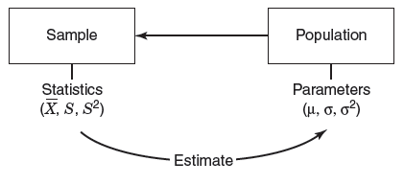
Statistics versus Parameters
The relation between sample and population

Slide 8
The Sampling Process
Major steps in sampling:
  Define the population.
  Determine the appropriate sample size
  Execute the sampling process

Slide 9
Sampling Techniques
Probability sampling: elements in the population have equal probabilities to be chosen.
Nonprobability sampling: the elements in the population do not have equal probabilities to be chosen.

Slide 10
Sampling Techniques
Probability Sampling
  Simple Random Sampling
  Systematic Sampling
  Stratified Random Sampling
  Cluster Sampling
Nonprobability Sampling
  Convenience Sampling
  Judgment Sampling
  Quota Sampling

Slide 11
Simple Random Sampling
Procedure
  Each element has a known and equal chance of being selected
Characteristics
  Highly generalizable
  Easily understood
  Reliable population frame necessary

Slide 12
Systematic Sampling
Procedure
  Each n^{th} element, starting with random choice of an element between 1 and n
Characteristics
  Similar to simple random sampling
  Easier than simple random sampling

Slide 13
Stratified Sampling
Strata: is a level or class to which people are assigned according to their social status, job level, or income, etc..
Procedure
  Divide of population in strata (levels)
  Include all strata
  Random selection of elements from strata
A president of a company is concerned about low motivational levels or high absenteeism rates among the employees.
He can stratify the population of organizational members according to their job levels (managers, seniors, juniors).

Slide 14
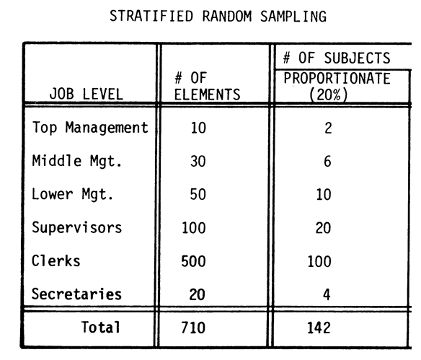
Example

Slide 15
Cluster Sampling
Procedure
  Divide of population in clusters
  Random selection of clusters
  Include all elements from selected clusters
A specific type of cluster sampling is area sampling.
If a company wants to survey its customers in Egypt.
They can divide the entire country’s population into cities (clusters)
And further select cities with the largest customer number.

Slide 16
Sample size: guidelines
In general: 30 < n < 500
Experiments: 15 to 20 per condition

Slide 17
Nonprobability sampling
Convenience sampling refers to the collection of information from members of the population who are conveniently available to provide it.
Judgment sampling design is used when a limited number or category of people have the information that is sought.
Quota sampling, a second type of purposive sampling, ensures that certain groups are adequately represented in the study through the assignment of a quota.

Slide 18
Quantitative Data Analysis
18

Slide 19
Getting the Data Ready for Analysis
Data coding: assigning a number to the participants’ responses so they can be entered into a database.
Data Entry: after responses have been coded, they can be entered into a database. Raw data can be entered through any software program (e.g., SPSS)

Slide 20
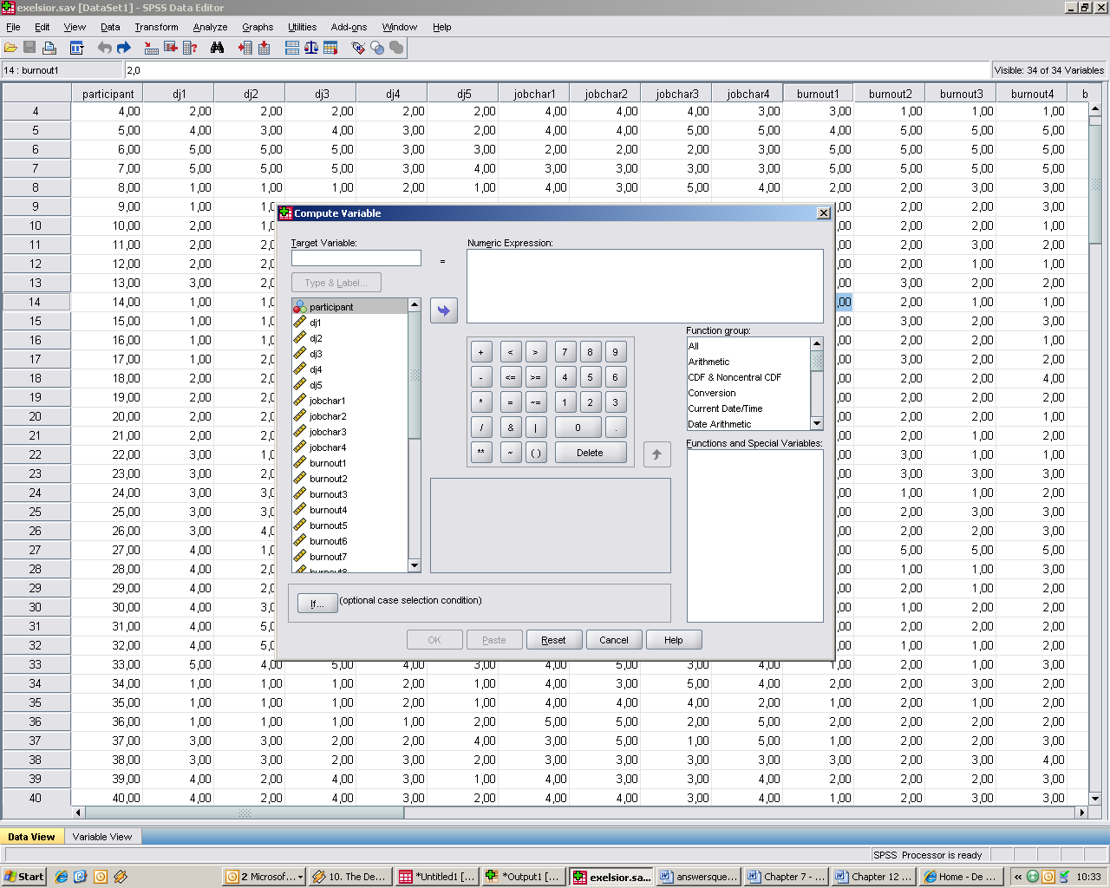
Transforming Data

Slide 21
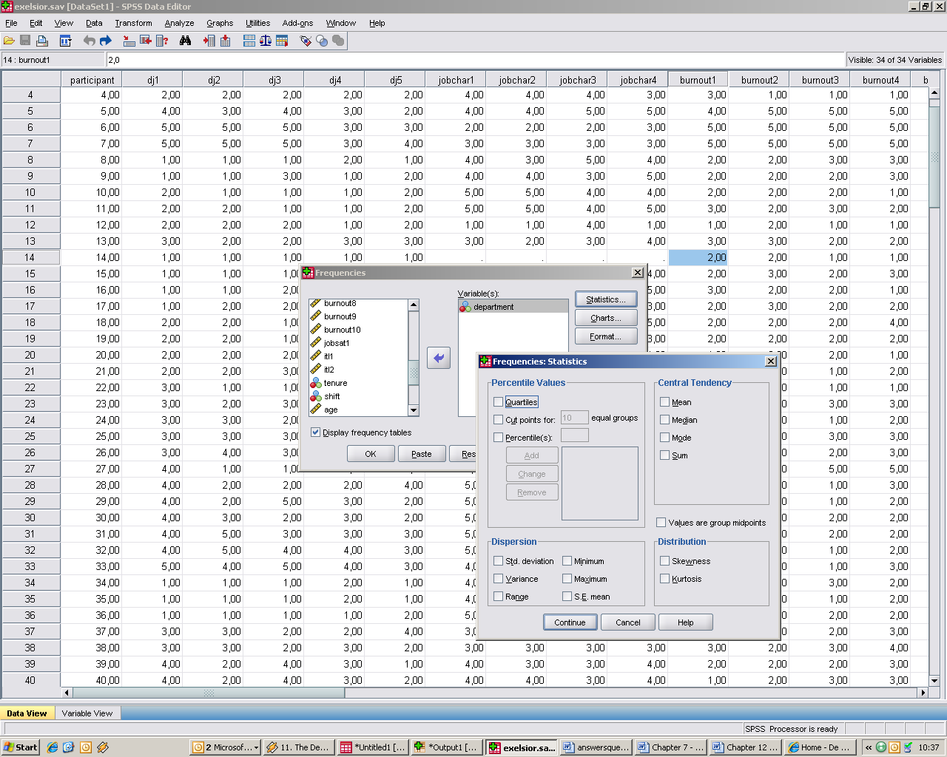
Frequencies

Slide 22
Correlation
Correlation Factor : -1 to 1
Positive correlation greater than 0 and less then 1
Negative correlation less than 0 and greater then -1

Slide 23
Testing Hypotheses about Two Unrelated Means
Independent samples t-test: is done to see if there are any significant differences in the means for two groups in the variable of interest.

Slide 24
Comparing 2 groups
significant effect on difference

Slide 25
Testing Hypotheses for more than 2 groups
ANOVA: examines differences between the means of more than 2 groups .

Slide 26
Comparing more than 2 groups
significant effect on difference

Slide 27
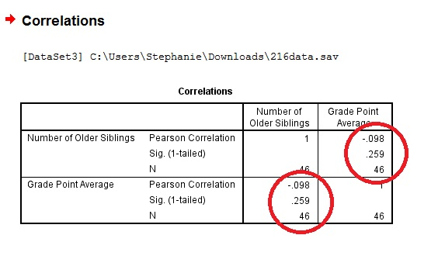
Correlation Coefficient

Slide 28
Qualitative Data Analysis
28

Slide 29
Analysis of Qualitative Data
The analysis of qualitative data is aimed at making valid inferences from the often overwhelming amount of collected data.
Steps:
  data reduction
  data display
  drawing and verifying conclusions

Slide 30
Data Reduction
Coding: the analytic process through which the qualitative data that you have gathered are reduced, rearranged, and integrated to form theory.
Categorization: is the process of organizing, arranging, and classifying coding units.

Slide 31
Data Display
Data display: taking your reduced data and displaying them in an organized, condensed manner.
Examples: charts, matrices, diagrams, graphs, frequently mentioned phrases, and/or drawings.

Slide 32
Drawing Conclusions
At this point where you answer your research questions by determining what identified themes stand for, by thinking about explanations for observed patterns and relationships, or by making contrasts and comparisons.

Slide 33
The Research Report

Slide 34
The Written Report
Important to identify the purpose of the report, so that it can be tailored accordingly.
Examples
  Simple descriptive report
  Comprehensive report, offering alternative solutions

Slide 35
Characteristics of a Well-Written Report
Clarity
Conciseness
Coherence
The right emphasis on important aspects
Meaningful organization of paragraphs
Smooth transition from one topic to the next
Apt choice of words
Specificity

Slide 36
The research document
•
•
•
Title page Contents page
Acknowledgements - personal thanks to those who have helped you
Executive summary or abstract – why, how and what? Introduction
Literature review – what others have said about this problem
Research method – what considerations were made when choosing a way to conduct this study
Data – what have you found from your primary data collection? Discussion – comparing literature to data section
Conclusions - answers to your research questions, limitations and future study advice
References - cited work - use appropriate referencing – APA 6.
Bibliography - sources used but not cited Appendices
•
•
•
•
•
•
•
•
•
•

Slide 37
Research Project
Research Report as a Process
Research Report as an Output

Slide 38
Title of the research
It should be concise, descriptive and informative.
Titles should clearly indicate the independent, dependent and /or mediating variables.
It is important to specify what population will be investigated.
The aim of a title is to capture the reader’s attention to the research problem being investigated

Slide 39
Example
The Impact of Employee Engagement on Employee Performance in the Egyptian Manufacturing Companies
A Dissertation Proposal
Submitted in Partial Fulfillment of the Requirement
For the DBA Degree
By:
Your Name
Supervised By:
Your Supervisor
2021

Slide 40
Content Page
Consider setting up any Headers or Footers here
Section the Report: Part I, Part II, Part III
State what each part is about e.g. Part I – Overview of relevant Information Security Standards
Use headings and sub-headings where applicable
Include the Appendices e.g. Appendix I - Company Accounts, Appendix II - …...

Slide 41
Executive Summary/ Abstract
Page Numbering starts here
Executive Summary usually about one half or two thirds of a page
What is it? It is a summary of the report
When do I write it? When you have completed your report!
Who reads it? It will be read by those who do not have time to read the full report

Slide 42
Main Content
Get the information across
Critical account of the “truth”
Presentation of facts
Discussion and analysis
Should expand on introduction and be foundation for conclusion
The area where the majority of your references should be found

Slide 43
Main Content
Diagrams & Graphs should be used to summarise complicated information
Remember to cite any data and make clear where tables and diagrams are made by you!
Complicated data should be put in the appendices
Develop a research map – Flow of your work

Slide 44
The Introduction
•
Setting the research problem/ background – Why? What? Who? Where? When? How?
A statement of purpose(s), objectives or aims
Background information on the report topic
Why is this report important etc.
What “problem” are you trying to solve
Report structure statement at the end of introduction – how are you going to structure the “solution”
•
•
•
•
•

Slide 45
Literature review
In this section what is already known about the topic is written including.
You do not need to report on every published study in the area of your research topic.
Choose those studies which are most relevant and most important.

Slide 46
Literature review
Reviews of the literature are not summaries, they are arguments that:
There is a gap that needs filling;
You have sound reasons for believing your hypotheses are likely to be true;
Your methods have been well thought through in relation to your research goals.

Slide 47

The narrative of a good
Literature Review
Reader
knows
Reader doesn't know

Slide 48
The narrative of a good
Literature Review
General Topic
Resource Based View
Notes:
Narrow down areas
Be more specific
Emphasis on area of interest

Slide 49
The narrative of a good
Literature Review
Focus on certain aspects in field of interest
Importance of Human Capital
Notes:
Narrow down areas
Be more specific
Emphasis on area of interest

Slide 50
The narrative of a good
Literature Review
Turn over
End with gap analysis
Notes:
Based on previous sections, what is not known?
Identify the specific problem
Ends in your research question / hypothesis
HOW DOES YOUR HYPOTHESIS FILL THE GAP-→ RELEVANCE AND NOVELTY

Slide 51
Aim / Purpose
Two types of objectives
  General/broad/overall;
  Specific
The aim is about what you hope to do, your overall intention in the project.
It’s what you want to know.
An aim is therefore generally broad.
The Aim is the WHAT of the research, and the objective is the HOW.

Slide 52
Objectives
The objectives are the specific steps you will take to achieve your aim.
Research objectives are the goals to be achieved by conducting the research.
Objectives should be:
  Logical and coherent
  Feasible and Realistic,
  Contextual/consistent to the title
  Distinctive, quantifiable, measurable
  Expressed in simple language, precise, self explanatory

Slide 53
Objectives
How should objectives be stated?
Objectives should be stated using “action verbs” that are specific enough to be measured:
e.g. To determine …, To compare…, To verify…, To investigate…, To describe…, etc.
Do not use vague non-action verbs such as: To appreciate, To understand… To believe.

Slide 54
Example
General objective (Aim / Purpose):
To examine the factors affecting employees turnover.
Specific objectives:
To investigate the impact of employee engagement on employee turnover
To investigate the impact of employee satisfaction on employee turnover.
To investigate the role of mangers in employee turnover.

Slide 55
Significance of the study
Academic Significance.
Practical Significance.

Slide 56
Questions and/or hypotheses
A hypothesis can be defined as a tentative prediction or explanation of the relationship between two or more variables.
Unambiguous prediction of expected outcomes
Null and Alternative Hypothesis
  Guide/lead the research

Slide 57
Questions and/or hypotheses
Example:
Ho (Null Hypothesis):
  There is no relation between employee engagement and employee performance.
H_A: Alternative Hypothesis
  There is a relation between employee engagement and employee performance.
  There is positive relation between employee engagement and employee performance

Slide 58
Methodology
Overview of the selected approach
Sampling design.
Justify your method choice.
Instrumentation and Operational definitions of terms used.
Unit of Analysis.
Data Collection techniques.
Data processing, analysis, interpretation techniques.
Interpretation.

Slide 59
Writing conclusions
Conclusions referring to
  research questions
  research objectives (outputs)
  research aims (outcomes)
Recommendations
  who are your findings aimed at and who do you want them to be used?
  How are you suggesting to resolve the research problem?
Limitations of your study
Suggestions for future work in the area
Reflection on the research process adopted

Slide 60
Basic writing skills
Top down:
  Start with a draft structure and fill out the sections and paragraphs
Bottom up:
  Write and then re-format and re-structure to present a logical flow of your work
PDCA:
  Pre-write
  Draft
  Check
  Act “Submit your work"

Slide 61
Writing style
Reports are written in third person form, that is, the use of “I” or “We” and their respective cases are not used
Instead of writing “I found that ….” write “It was evident that ….” “The statistics revealed that ….”
There are exceptions such as personal reflections etc

Slide 62
APA referencing
Difference between referencing and bibliography
Author (year) – citation (Author, year)
E.g. Bell (2010) in the text and make a full reference at the end of the document:
  Bell, F. (2010) Learning to reference. Hannagan 5th edition: London
Full reference at the back of your report
Free tools available that can help:
  Medley
  End Note

Slide 63
Last sections of your report
References
Bibliography
Appendix

Slide 64
Plagiarism
Citing others work is good – evidence of research
Using someone else's work without attribution – very bad practice and carries substantial penalties
Learn to paraphrase and reference your sources

