Slide 1


Slide 2
Business Research Methodology
By:
Dr. Ashraf Shaarawy

Slide 3
Chapter 7
Measurement of Variables: Scaling, Reliability, Validity
3

Slide 4
Scale
Scale: tool or mechanism by which individuals are distinguished as to how they differ from one another on the variables of interest to our study.

Slide 5
Scales and Measurement
Scales
  Nominal scale
  Ordinal scale
  Interval scale
  Ratio scale
Rating scale
  Likert scale
  Itemized rating scale

Slide 6
Nominal Scale
  A nominal scales categorize individuals or objects into mutually exclusive and collectively exhaustive groups.
What is your department?
O Marketing O Maintenance O Finance
O Production O Servicing O Personnel
O Sales O Public Relations O Accounting
What is your gender?
O Male
O Female

Slide 7
Ordinal Scale
Ordinal scale: not only categorizes variables in such a way as to denote differences among various categories, it also rank-orders categories in some meaningful way.
What is the highest level of education you have completed?
Job characteristic | Rank of importance
The job provide interaction with others
Use a number of different skills.
Complete a whole task from start to end
Serve others
Work independently.

Slide 8
Interval Scale
Interval scale: the interval scale lets us measure the distance between any two points on the scale.
The difference between any two values on
the scale is identical to the difference between any other two neighboring values of the scale.

Slide 9
Interval scale
Circle the number that represents your feelings at this particular moment best. There are no right or wrong answers. Please answer every question.
1. I invest more in my work than I get out of it
I disagree completely 1 2 3 4 5 I agree completely
2. I exert myself too much considering what I get back in return
I disagree completely 1 2 3 4 5 I agree completely
3. For the efforts I put into the organization, I get much in return
I disagree completely 1 2 3 4 5 I agree completely

Slide 10
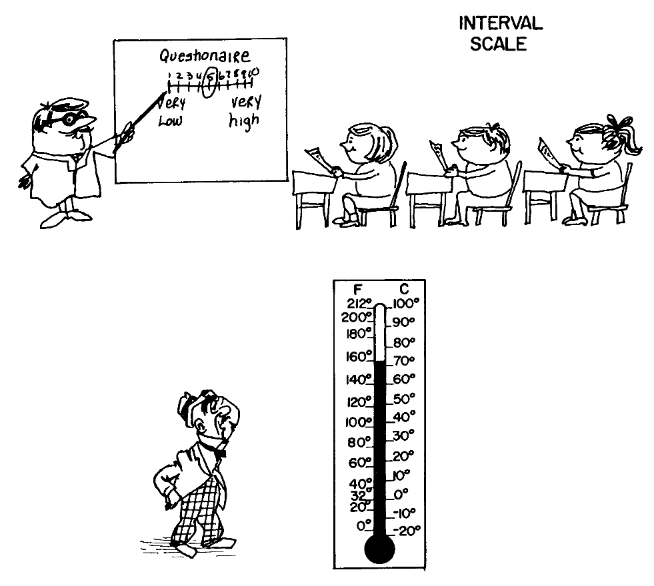
Interval scale
The clinical thermometer is a good example of an interval-scaled instrument; it has an arbitrary origin and the magnitude of the difference between 37 degrees and 38 degrees is the same as the difference between 40 and 41 degrees.

Slide 11
Ratio Scale
Ratio scale: overcomes the disadvantage of the arbitrary origin point of the interval scale, in that it has an absolute (in contrast to an arbitrary) zero point, which is a meaningful measurement point.
What is your age?

Slide 12
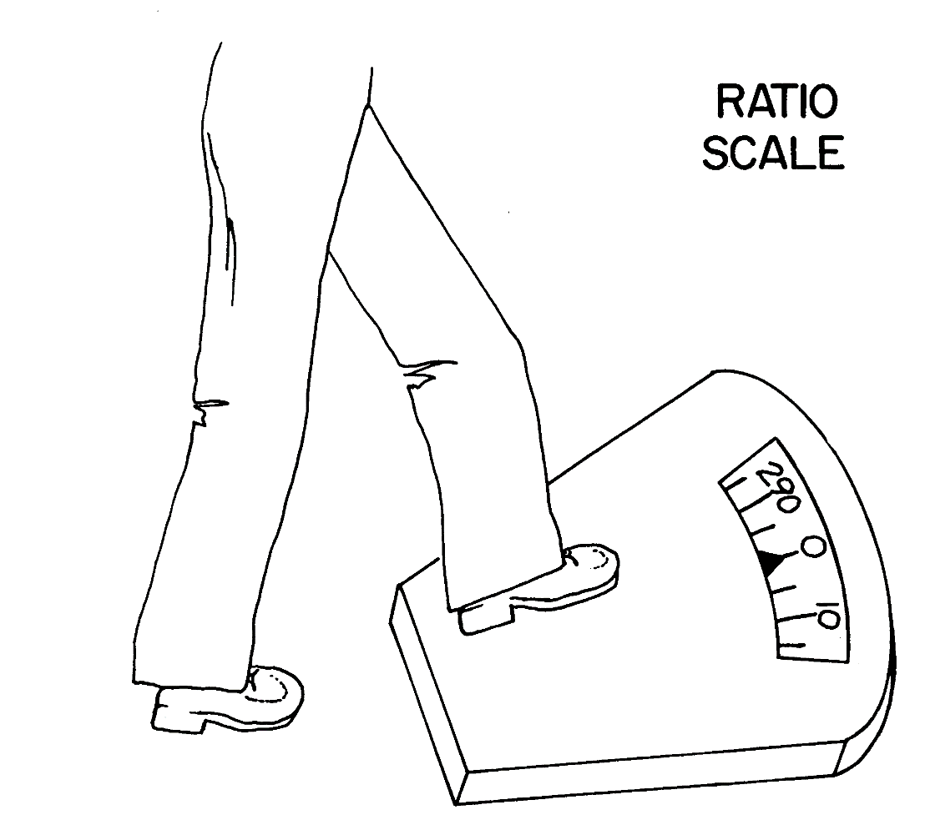
Ratio Scale

Slide 13
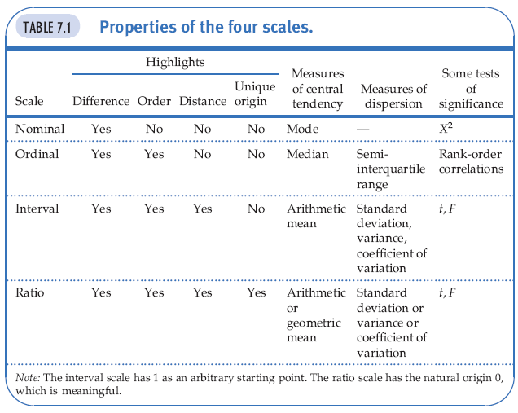
Properties of the Four Scales

Slide 14
Validity of the Measure
Validity refers to the ability or the potential of our data collection tool to capture and measure the construct or the phenomenon that we are interested in measuring.

Slide 15
Reliability
Reliability of measure indicates extent to which it is without bias (error free) and hence ensures consistent measurement across time (stability) and across the various items in the instrument (internal consistency).

Slide 16
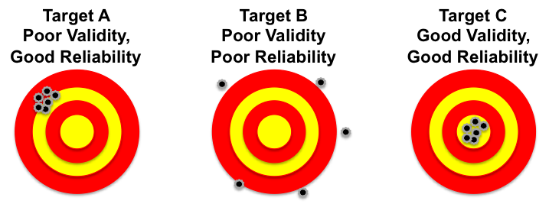
Reliability and Validity

Slide 17
Types of Validity
Content validity ensures that the measure includes an adequate and representative set of items that tap the concept.
  Face validity indicates that the items that are intended to measure a concept, do, on the face of it, look like they measure the concept.
  Face validity is considered by some a basic and minimum index of content validity.

Slide 18
Types of Validity
Criterion-related validity is established when the measure differentiates individuals on a criterion it is expected to predict. It has two parts:
  Concurrent validity when the scale discriminates individuals who are known to be different; that is, they should score differently on the instrument.
  Example: Measuring: Employee’s Commitment
  Predictive validity indicates the ability of the measuring instrument to differentiate among individuals with reference to a future criterion.
  Example: Measure aptitude or ability test of employees at the time of recruitment

Slide 19
Types of Validity
Construct validity is similar to content validity in that it measures the level or the degree that a measurement is able to truly measure the construct.
It is related to the degree that our operationalization of a construct is accurately done.
  Convergent validity when the scores obtained with two different instruments measuring the same concept are highly correlated.
  Discriminant validity when, based on theory, two variables are predicted to be uncorrelated, and the scores obtained by measuring them are indeed empirically found to be so.

Slide 20
Construct validity
Example, if organization’s knowledge is related to its performance, how can we assure that we measure organizational knowledge and not organizational performance?
Convergent validity: by comparing the observed values of one indicator of one construct with that of other indicators of the same construct and demonstrating similarity (or high correlation) between values of these indicators.
Discriminant validity is established by demonstrating that indicators of one construct are dissimilar from (i.e., have low correlation with) other constructs.

Slide 21
Types of Validity
Validity | Description
Content validity | Does the measure adequately measure the concept?
Face validity | Do “experts” validate that the instrument measures what is name suggests it measures?
Criterion-related validity | Does the measure differentiate in a manner that helps to predict a criterion variable?
Concurrent validity | Does the measure differentiate in a manner that helps to predict a criterion variable currently?
Predictive validity | Does the measure differentiate individuals in a manner as to help predict a future criterion?
Construct validity | Does the instrument tap the concept as theorized?
Convergent validity | Do two instruments measuring the concept correlate highly?
Discriminant validity | Does the measure have a low correlation with a variable that is supposed to be unrelated to this variable?

Slide 22
Reliability
Stability of measures
  Test-retest reliability
  Parallel-form reliability
Internal consistency of measures
  Inter-item consistency reliability
  Split-half reliability

Slide 23
Stability
Stability: ability of a measure to remain the same over time, despite uncontrollable testing conditions or the state of the respondents themselves.
  Test–Retest Reliability: The reliability coefﬁcient obtained with a repetition of the same measure on a second occasion.
  Parallel-Form Reliability: Responses on two comparable sets of measures tapping the same construct are highly correlated.
    Both forms have similar items and the same response format, the only changes being the wording and the order or sequence of the questions.

Slide 24
Internal Consistency
Internal Consistency of Measures is indicative of the homogeneity of the items in the measure that tap the construct.
  Inter-item Consistency Reliability: a test of the consistency of respondents’ answers to all the items in a measure. The most popular test is the Cronbach’s coefﬁcient alpha.
  Split-Half Reliability: Split-half reliability reflects the correlations between two halves of an instrument.

Slide 25
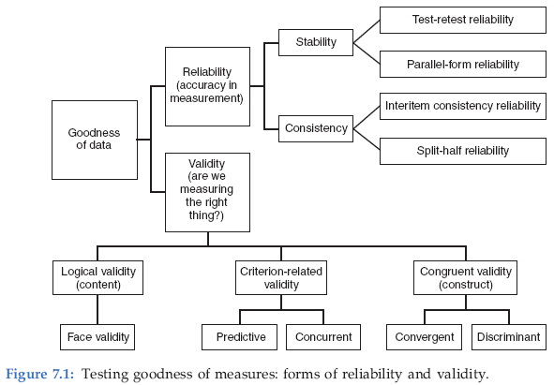
Goodness of Measures

Slide 26
Principles of measurement
These principles of measurement encompass:
the scales and scaling techniques used in measuring concepts,
the assessment of reliability and validity of the measures used.

Slide 27
Chapter 8
Data Collection Methods
27

Slide 28
Sources of Data
Primary data: information obtained ﬁrst-hand by the researcher on the variables of interest for the specific purpose of the study.
Types of Primary Data:
  Quantitative:
  Qualitative
Examples: individuals, focus groups, panels
Secondary data: information gathered from sources already existing.
Examples: company records or archives, government publications, industry analyses offered by the media, web sites, the Internet, and so on.

Slide 29
Quantitative Data
Quantitative data are measures of values or counts and are expressed as numbers. It is about numeric variables.
Examples:
1. I invest more in my work than I get out of it
completely disagree 1 2 3 4 completely agree
2. I exert myself too much considering what I get back in return
completely disagree 1 2 3 4 completely agree

Slide 30
Qualitative Data
Qualitative data: data in the form of words.
Examples: interview notes, transcripts of focus groups, answers to open-ended questions, transcription of video recordings, accounts of experiences with a product on the internet, news articles, and the like.

Slide 31
Data Collection Methods, Settings, and Sources of Data
Data collection methods include:
  Interview:
    face to face interviews,
    telephone interviews,
    computer-assisted interviews;
  Questionnaires that are either personally administered, sent through the mail, or electronically administered;
  observation of individuals and events with or without videotaping or audio recording.

Slide 32
Other Methods of Data Collection
Observational surveys
  Nonparticipant-observer
  Participant-observer
  Structured versus unstructured observational studies
Biases in observational studies
Data observed from the researcher’s point of view are likely to be prone to observer biases. Moreover, where several observers are involved, interobserver reliability has to be established before the data can be accepted. Observer fatigue could also be a source of bias.

Slide 33
Some Special Data Sources
Focus groups: consist typically of eight to ten members with a moderator leading the discussions on a particular topic, concept, or product.
Members are generally chosen on the basis of their familiarity with the topic on which information is sought.
Panel Interview: is a group of people specifically selected by the researcher to elicit expert
knowledge and opinion about a certain issue.
Example: group of experts in IOT, Cloud Computing

Slide 34
Some tips to follow while interviewing
  Establishing credibility and rapport, and motivating individuals to respond
  The questioning technique
    Funneling
    Unbiased questions
    Clarifying issues
    Helping the respondent to think through issues
    Taking notes

Slide 35
Interview
Personal Interview
Advantages
  clarify doubts about questionnaire
  pick up non-verbal cues
  high response/cooperation
Disadvantages
  High costs and time intensive
  Geographical limitations
  Response bias
Telephone Interview
Advantages
  Discomfort of face to face is avoided
  Number of is high
  Lower cost
Disadvantages
  Interview length is limited
  Low response rate
  No facial expressions

Slide 36
Data Collection
Self Administered
Advantages
  Lowest cost option
  Expanded geographical coverage
  Requires minimal staff
  Perceived as more anonymous
Disadvantages
  Low response rate in some modes
  No interviewer intervention possible for clarification
  Incomplete surveys
Observations
Recording prespecified behavioral patterns of people, objects and events in a systematic manner.
Different types
  Personal observation
  (e.g., mystery shopper)
  Electronic observation
  (e.g., Video Recording, CCTV)

Slide 37
Questionnaire Design
A questionnaire is a pre-formulated, written set of questions to which the respondent records his answers
Steps
    Determine the content of the questionnaire
    Determine the form of response
    Determine the wording of the questions
    Determine the question sequence
    The personal data of respondents.
    Write cover letter

Slide 38
1. Questionnaire content
Framework
  Need information for all constructs in framework
Measurement: Operationalizing
  Objective construct:
    1 element/items
    => 1 question
  Subjective construct:
    multiple elements/items
    => multiple questions

Slide 39
2. Response format
Closed vs. Open-ended questions
  Closed questions
    Helps respondents to make quick decisions
    Helps researchers to code
  Open-ended question
    Unbiased point of view
    Getting additional insights
    Complementary to closed question: for interpretation purpose

Slide 40
3. Question Wording
Avoid double-barreled questions
Avoid ambiguous questions and words
Avoid leading or biasing questions
Social desirability
Avoid recall depended questions

Slide 41
Double-barreled questions
A question consists of more that one part is called a double-barreled question.
Two or more separate questions asked instead.
Example, “Do you think there is a good market for the product and that it will sell well?”
Solution: it would be better to ask two questions:
(1) “Do you think there is a good market for the product?”
(2) “Do you think the product will sell well?”

Slide 42
Ambiguous questions
Questions about concepts or constructs before operationalization
An example of such a question is “To what extent would you say you are happy?”

Slide 43
leading or biasing questions
Questions that lead the respondents to give the responses that the researcher would like them to give
Example: “Don't you think that in these
days of escalating costs of living, employees should be given good pay rises?”
Solution :“To what extent do you agree that
employees should be given higher pay rises?”

Slide 44
Loaded questions
Another type of bias in questions occurs when they are phrased in an emotionally charged manner.
An example of such a loaded question is asking employees: “To what extent do you think management is likely to be vindictive
if the employees decide to go on strike?”

Slide 45
Social desirability
Questions should not be worded such that they elicit socially desirable responses.
Example: “Do you think that older people should be laid off?”
Solution: “There are advantages and disadvantages to retaining senior citizens in the workforce. To what extent do you think
companies should continue to keep the elderly on their payroll?”

Slide 46
Recall-dependent questions
Some questions require respondents to recall experiences from the past that are hazy in their
memory.
If an employee with 30 years' service in the organization is asked when he first started working in a particular department and for how long.
He may not be remember the correct answers.
A better source for obtaining that information would be the personnel records.

Slide 47
Question Wording
Use positive and negative statements
  it is advisable to include some negatively worded questions
  as well, so the tendency in respondents to mechanically circle the points toward one end of the scale is
  minimized.
  Avoid double negatives
Example:
I feel I have been able to accomplish a number of different things in my job.
I do not feel I am very effective in my job.”
The respondent is now shaken out of any likely tendency to mechanically respond to one end of the scale.

Slide 48
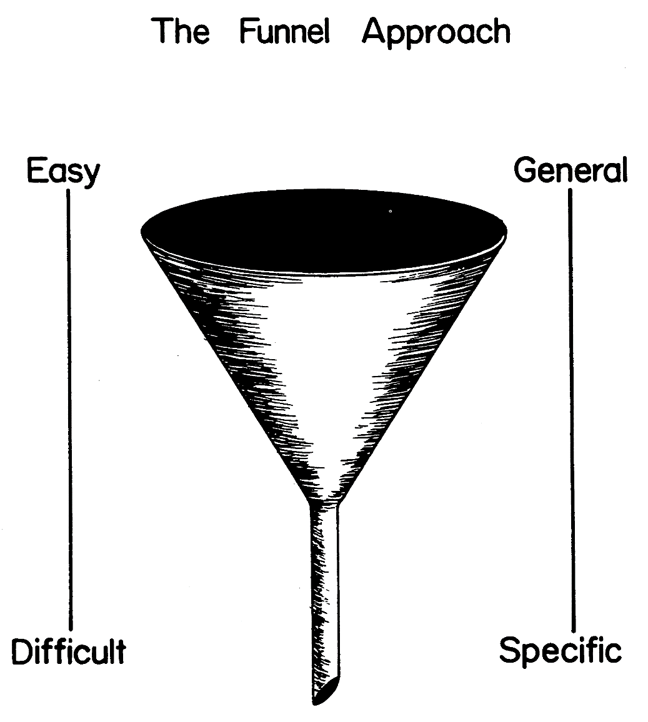
4. Question Sequence
Personal and sensitive data at the end
© 2009 John Wiley & Sons Ltd.
www.wileyeurope.com/college/sekaran

Slide 49
5. Personal data Demographic or personal data
Demographic information preferred to be at the beginning of the questionnaire.
Information of a very private and personal nature such as income, state of health should be asked at the end of the questionnaire.

Slide 50
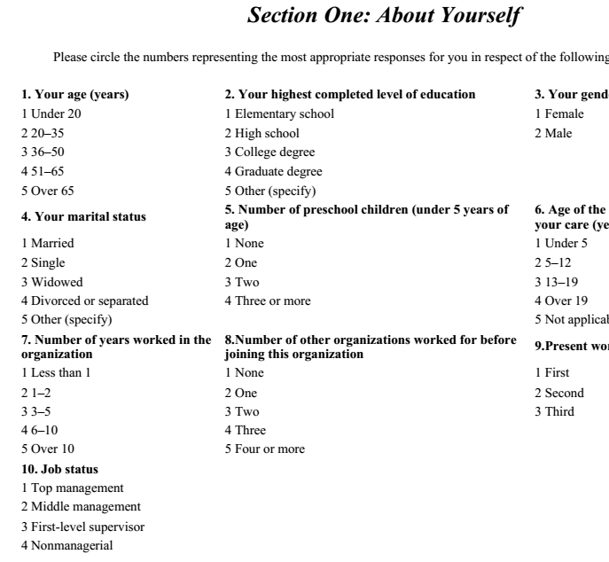

Slide 51
6. Cover Letter
The cover letter is the introductory page of the questionnaire
It includes:
  Identification of the researcher
  Motivation for respondents to fill it in
  Confidentiality
  Thanking of the respondent

Slide 52
General appearance or “getup” of the questionnaire
it is also necessary to pay attention to how the questionnaire looks.
An attractive and neat questionnaire with appropriate introduction, instructions, and well-arrayed set of questions and response alternatives will make it easier for the respondents to answer them.
A good introduction, well-organized instructions, and neat alignment of the questions are all important. These elements are briefly discussed with examples.

