Slide 1


Slide 2
Business Research Methodology
By:
Dr. Ashraf Shaarawy

Slide 3
Chapter 3
The Research Process - The Broad Problem Area and Defining the Problem Statement
3

Slide 4
The Broad Problem Area
Examples of broad problem areas that a manager could observe at the workplace:
  The newly installed information system is not being used by the managers for whom it was primarily designed.
  Training programs are not as effective as anticipated.
  The sales volume of a product is not picking up.
  The introduction of flexible work hours has created more problems than it has solved in many companies.

Slide 5
Preliminary Information Gathering
Nature of information to be gathered:
  Background information of the organization.
  Prevailing knowledge on the topic.

Slide 6
Literature Review
A good literature survey:
  Ensures that important variables are not left out of the study.
  Helps the development of the theoretical framework and hypotheses for testing.
  Ensures that the problem statement is precise and clear.
  Enhances testability and replicability of the findings.
  Reduces the risk of “reinventing the wheel”.
  Confirms that the problem is perceived as relevant and significant.

Slide 7
Data sources
Textbooks
Academic and professional journals
Thesis
Conference proceedings
Unpublished manuscripts
Reports of governmental departments and corporations
Newspapers
The Internet

Slide 8
Searching for Literature
Most libraries have the following electronic resources at their disposal:
  Electronic journals
  Full-text databases
  Bibliographic databases
  Abstract databases

Slide 9
Google Scholar
Search on Google Scholar
https://scholar.google.com/

Slide 10
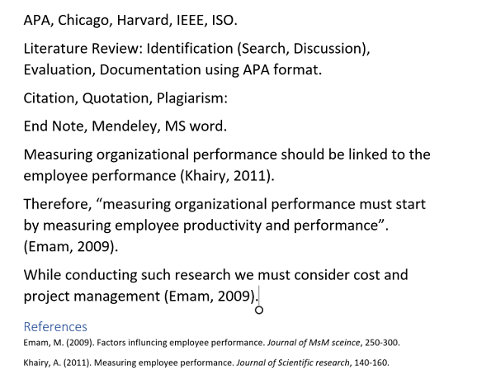
APA Format

Slide 11
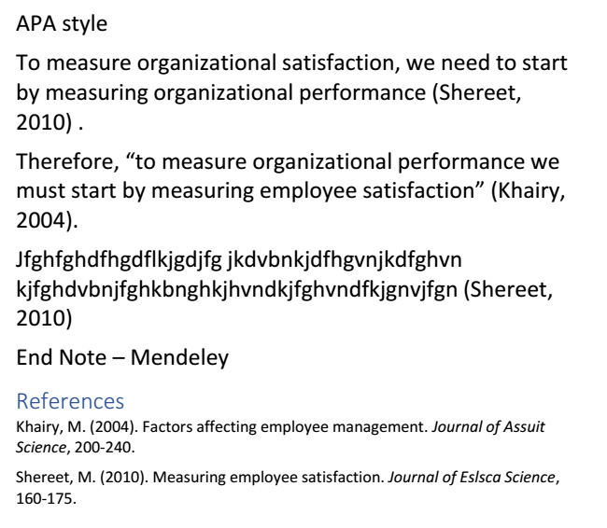

Slide 12
The Problem Statement
Examples of Well-Defined Problem Statements
  To what extent do knowledge-related factors affect the use of MIS by middle managers?
  To what extent do the structure of the organization and type of information systems installed account for the variance in the perceived effectiveness of managerial decision making?
  To what extent has the new advertising campaign been successful in creating the high-quality, customer-centered corporate image that it was intended to produce?
  What are the effects of downsizing on the long-range growth patterns of companies?

Slide 13
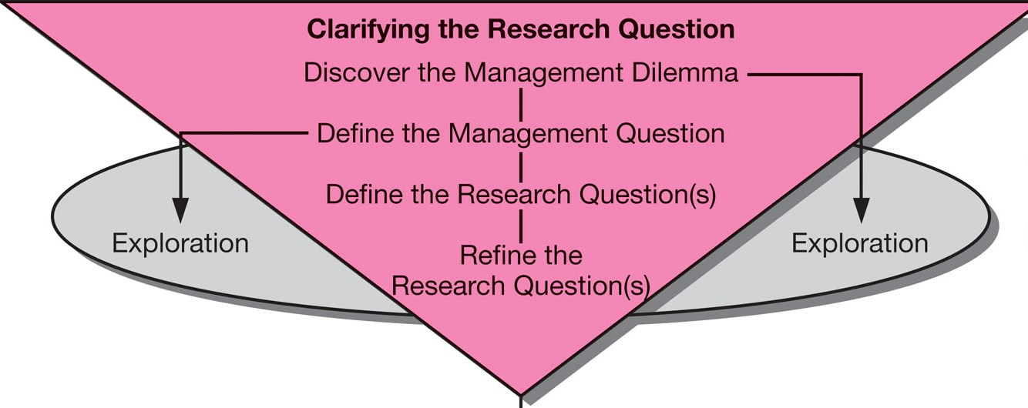
Stage 1:
Clarifying the Research Question
Management-research question hierarchy process begins by identifying the management dilemma

Slide 14
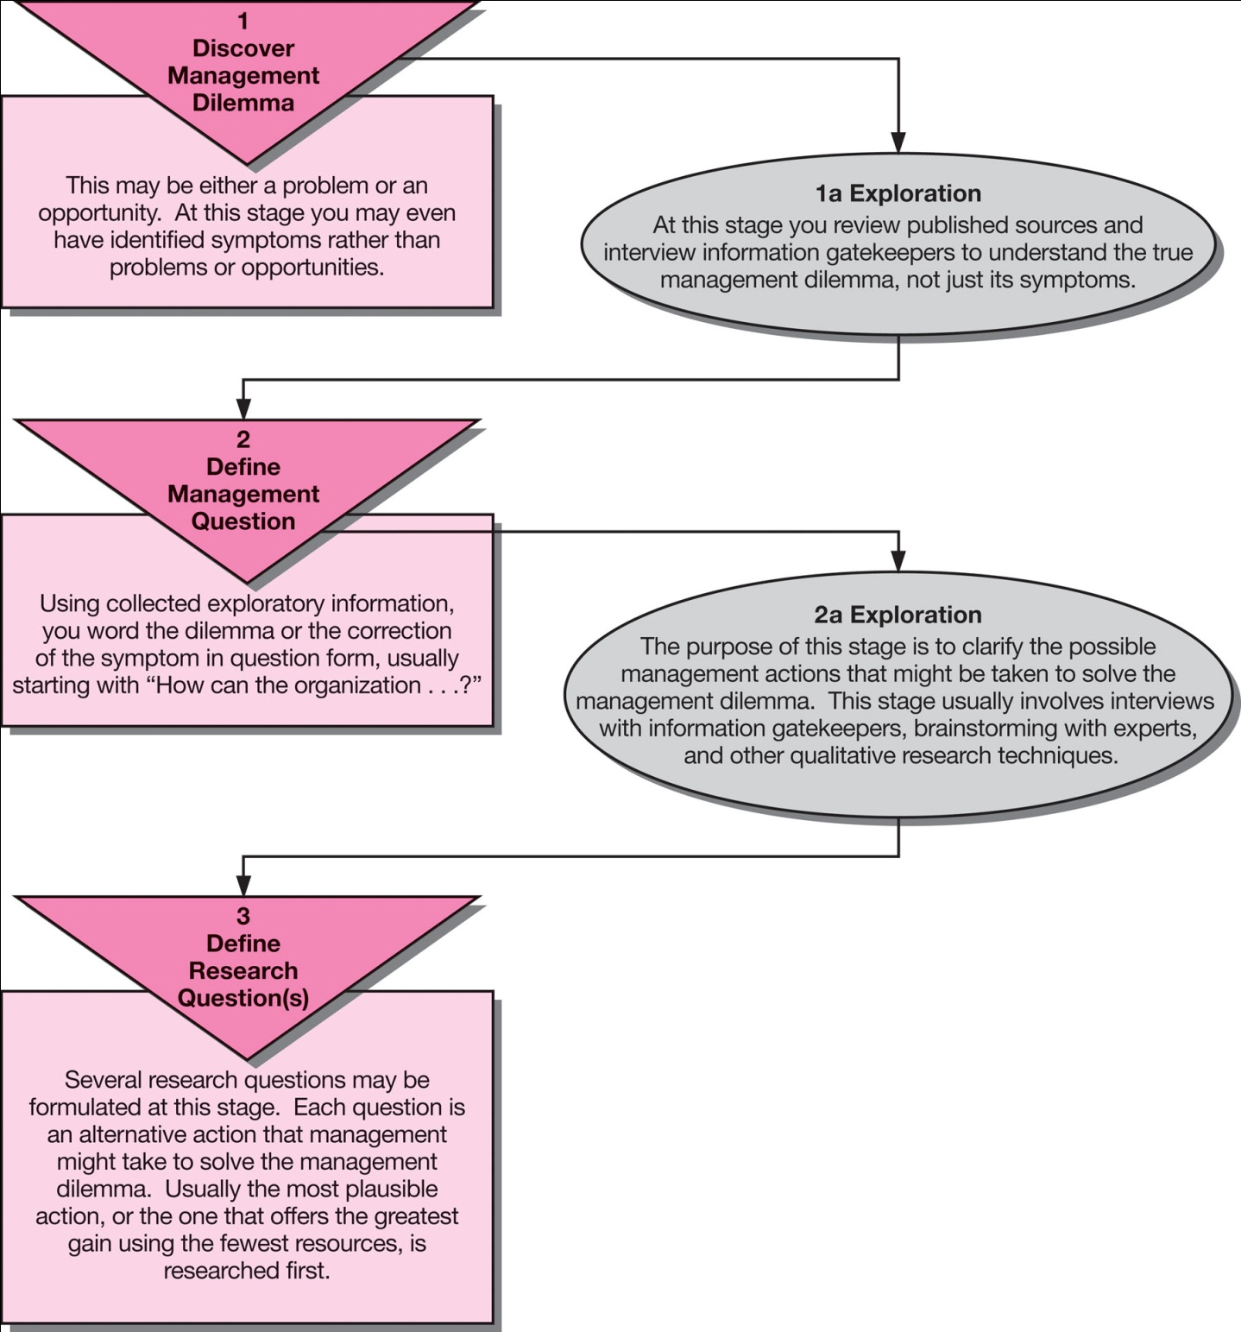
Formulating the Research Question

Slide 15
Chapter 4
The Research Process - Theoretical Framework & Hypothesis Development
15

Slide 16
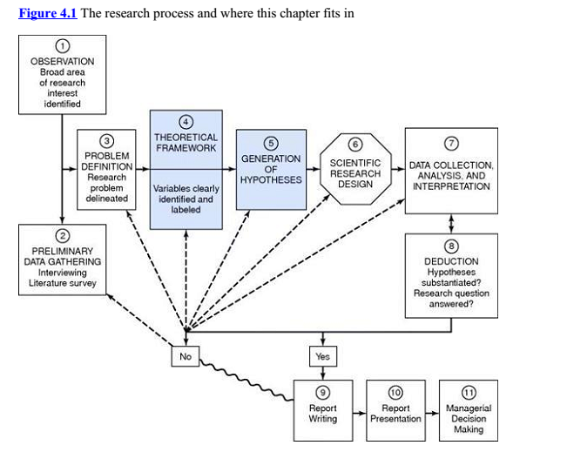

Slide 17
Theoretical Framework
A theoretical framework represents your beliefs on how certain phenomena (or variables or concepts) are related to each other (a model) and an explanation on why you believe that these variables are associated to each other (a theory).
A theoretical framework is the foundation of hypothetico‐deductive research as it is the basis of the hypotheses that you will develop.

Slide 18
Theoretical Framework
The process of building a theoretical framework includes:
Identify and label the variables correctly
State the relationships among the variables: formulate hypotheses
Explain how or why you expect these relationships

Slide 19
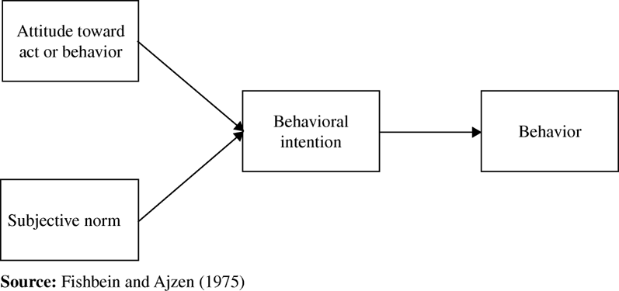
Example of Theoretical Framework
Theory of Reasoned Action - TRA

Slide 20
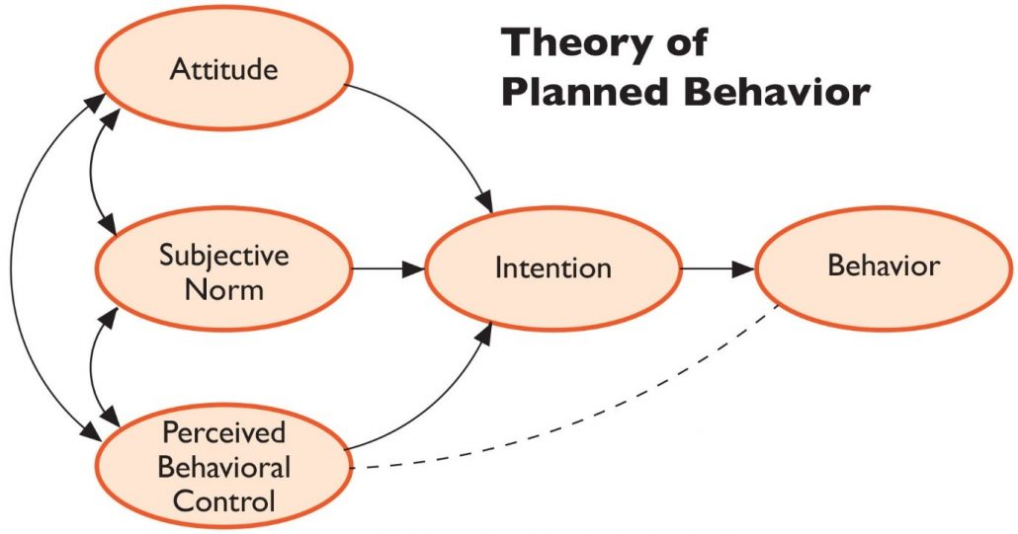
Example of Theoretical Framework

Slide 21
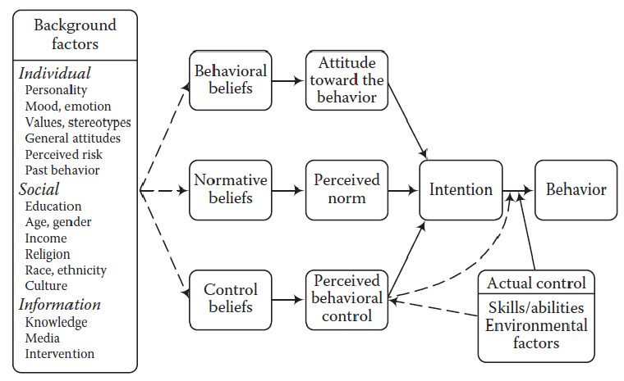
TPB in Marketing

Slide 22
Variable
Any concept or construct that varies or changes in value
Main types of variables:
  Dependent variable
  Independent variable
  Moderating variable
  Mediating variable
  Control Variables

Slide 23
(In)dependent Variables
Dependent variable (DV)
  Is of primary interest to the researcher. The goal of the research project is to understand, predict or explain the variability of this variable.
Independent variable (IV)
  Influences the DV in either positive or negative way. The variance in the DV is accounted for by the IV.
© 2009 John Wiley & Sons Ltd.www.wileyeurope.com/college/sekaran

Slide 24
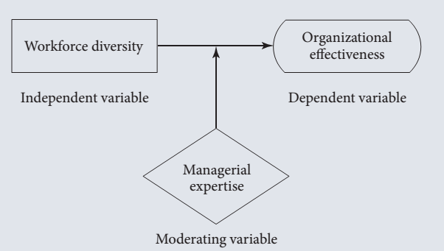
Moderators
Moderating variable: is a variable that affects the direction and/or strength of relation between independent and dependent variable. ( Motivation, Engagement, etc…)

Slide 25
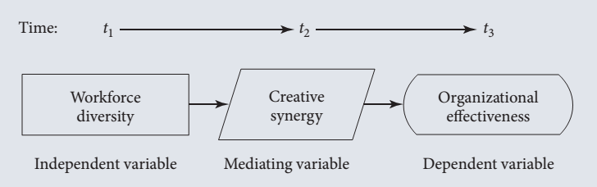
Mediating Variable
  It surfaces between the time the independent variables start operating to influence the dependent variable and the time their impact is felt on it.

Slide 26
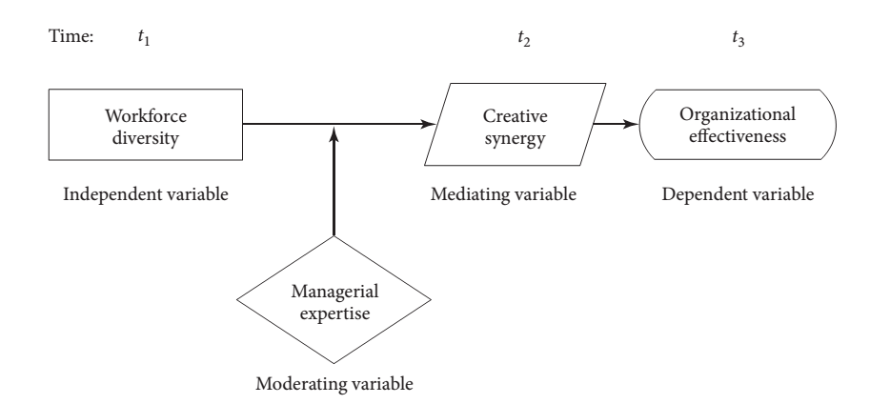
Theoretical Framework Example

Slide 27
Hypothesis
A proposition that is empirically testable. It is an empirical statement concerned with the relationship among variables.
Good hypothesis:
  Must be adequate for its purpose
  Must be testable
  Must be better than its rivals
Can be:
  Directional
  Non-directional

Slide 28
Hypothesis
Directional Hypothesis:
The greater the stress experienced in the job, the lower the job satisfaction of employees.
Women are more motivated than men.
Non Directional Hypothesis:
There is a relation between arousal‐seeking tendency and consumer preferences for complex Mobile phones.
There is a difference between Women and Men regarding shopping behavior.

Slide 29
Independent and Dependent Variable Synonyms
Independent Variable (IV)
Predictor
Presumed cause
Antecedent
Manipulated
Stimulus
Dependent Variable (DV)
Outcome
Presumed effect
Consequence
Measured outcome
Response

Slide 30
Control Variables
Control variables are any variable that can manipulate your variables of interest and as a result manipulate your findings in undesirable ways.
We include control variables our investigation to ensure that our results are not biased by not including them. Taking the example of the effect of the four-day working week again, one would normally think that weather conditions.

Slide 31
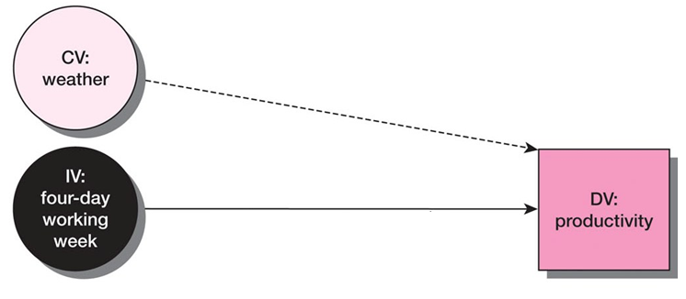
Control Variables

Slide 32
Chapter 5
The Research Process – Elements of Research Design
32

Slide 33
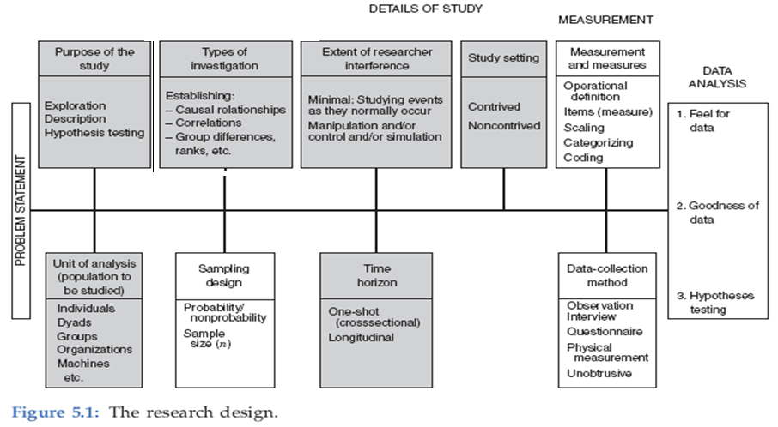
Research Design

Slide 34
Purpose of the Study
Exploration
Description
Hypothesis Testing (Explanatory)

Slide 35
Exploratory study:
  It is undertaken when don’t know not much about the situation at hand, or no information is available on how similar problems or research issues have been solved in the past.
  Example:
  A service provider wants to know why his customers are switching to other service providers?
  The maintenance Manager wants to sell maintenance Contracts

Slide 36
Descriptive study:
  Objective: to describe the characteristics of the variables of interest.
  In organizations: to describe the characteristics of a group of employees, their age, educational level and length of service.
  To understand the characteristics of organizations that follow certain common practices.
  Example, to describe the characteristics of the organizations that implement ERP or Service Marketing.

Slide 37
Descriptive study:
  Example, a bank manager wants to have a profile of the individuals who have loan payments outstanding for 6 months and more. It would include details of their average age, earnings, nature of occupation, full-time/part-time employment status, and the like. To help him to decide on the types of individuals who should be made ineligible for loans in the future.

Slide 38
Hypothesis testing (Explanatory)
  Studies that engage in hypotheses testing usually explain the nature of certain relationships, or establish the differences among groups or the independence of two or more factors in a situation.
  Example:
  A marketing manager wants to know if the sales of the company will increase if he doubles the advertising dollars.

Slide 39
Type of Investigation
Causal Study
  it is necessary to establish a definitive cause-and-effect relationship.
Correlational study
  identification of the important factors “associated with” the problem.

Slide 40
Study Setting
Research can be done in:
Non-contrived settings: The natural environment where events normally occur .
Contrived settings: artificial arrangement of the settings

Slide 41
Extent of Researcher Interference
The extent of researcher interference has a direct bearing on whether a causal or correlational study is undertaken.
Minimal: A correlational study is conducted in the natural environment of the organization with the researcher interfering minimally with the normal flow of events.
Moderate: in a Field Experiment
Excessive: In Lab Experiment causal studies conducted to establish cause → effect relationships, the researcher tries to manipulate certain variables to study the effects of such manipulation on the dependent variable of interest

Slide 42
The Field Study
Studies done in non-contrived settings
Exploratory and descriptive (correlational)
studies are invariably conducted in non-contrived settings.
Minimal Interference from Researcher

Slide 43
The Field Experiment
A field experiment is an experiment done in the natural environment in which events normally occur, with treatments given to one or more groups.
Moderate Interference from Researcher

Slide 44
The Laboratory (Lab) Experiment and The Field Experiment
The Lab Experiment : When a cause effect relationship is to be clearly established between in independent a dependent variable of interest
All other variables that might contaminate or confound the relationship have to be tightly controlled.
Maximum Interference from Researcher.
Contrived Settings

Slide 45
Unit of analysis
The unit of analysis refers to the level of aggregation of the data collected
Individuals: Researcher about motivational levels of employees is interested in individual employees.
Dyads: Analysis of husband–wife interactions in families and supervisor–subordinate relationships in the workplace.
Group: if the problem statement is related to group effectiveness.
Organizations: Start-ups VS established companies.
Cultures: Western VS Eastern cultures.

Slide 46
Time Horizon
Cross-sectional studies
  Snapshot of constructs at a single point in time
  Use of representative sample
Longitudinal studies
  Constructs measured at multiple points in time
  Use of same sample = a true panel

Slide 47
Ethical Issues in Research and Lab Experiments
The following practices are considered unethical:
  Putting pressure on individuals to participate in research (through coercion, applying social pressure, etc.)
  Asking demeaning questions that diminish their self-respect.
  Deceiving subjects by deliberately misleading them as to the true purpose of the research.
  Exposing participants to physical or mental stress.
  Not allowing them to withdraw from the research when they want to.
  Using the research results to disadvantage the participants, or for purposes that the participants would not like.
  Withholding benefits from control groups.

Slide 48
Chapter 6
Measurement of Variables: Operational Definition
48

Slide 49
Measurement
Measurement: the assignment of numbers or other symbols to characteristics (or attributes) of objects according to a pre-specified set of rules.

Slide 50
How Variables Are Measured
Objects that can be physically measured by some calibrated instruments pose no problem. Data representing several demographic characteristics of the office personnel are also easily obtained by asking employees simple, straight forward questions, for example:
  How long have you been working in this organization?
  What is your job title?
  What is your marital status?

Slide 51
Objects and Characteristics
Objects include persons, strategic business units, companies, countries, kitchen appliances, restaurants and so on.
Examples of characteristics of objects are achievement motivation, organizational effectiveness, shopping enjoyment, length, weight, ethnic diversity, service quality, conditioning effects and taste.

Slide 52
Types of Variables
Two types of variables:
  One lends itself to objective and precise measurement;
  The other is more nebulous “Vague” and does not lend itself to accurate measurement because of its abstract and subjective nature.

Slide 53
Concepts & Constructs
A scientific concept consists of three parts:
Concept Labels: facilitates communication.
Theoretical definition: the verbal meaning attached to the concept label.
Example: “Income”, refers to, the amount of money people receive in return for making labor or knowledge available to another.
Operational Definition: translates the verbal meaning provided by the theoretical definition into a prescription for measurement.

Slide 54
Operational Definition
Operationalizing, or operationally defining a concept so that it becomes measurable, is achieved by looking at the behavioral dimensions, facets, or properties denoted by the concept, and categorizing these into observable and measurable elements.

Slide 55
Operationalizing Concepts
Operationalizing concepts: reduction of abstract concepts to render them measurable in a tangible way.
Operationalizing is done by looking at the behavioural dimensions, facets, or properties denoted by the concept.

Slide 56
Operationalization: Dimensions and Elements
Example: Aggression has at least two dimensions:
Verbal aggression: shouting and swearing at a person
Physical aggression: throwing objects, hitting a wall, and physically hurting others
A valid measurement scale of aggression would have to include “Elements” that measure verbal aggression and “Elements” that measure physical aggression.
A measurement scale that only includes items measuring physical aggression would not be valid if our aim were to measure aggression.

Slide 57
Operationalization
Scale handbooks, such as the Marketing Scales Handbook or the Handbook of Organizational Measurement, provide an exhaustive overview of measurement scales that have appeared in the academic literature.

Slide 58
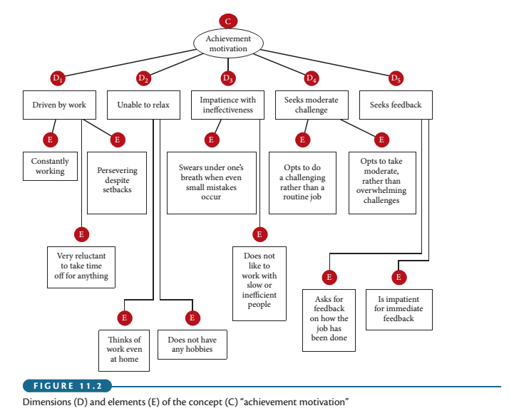
Achievement Motivation

